Slide 1
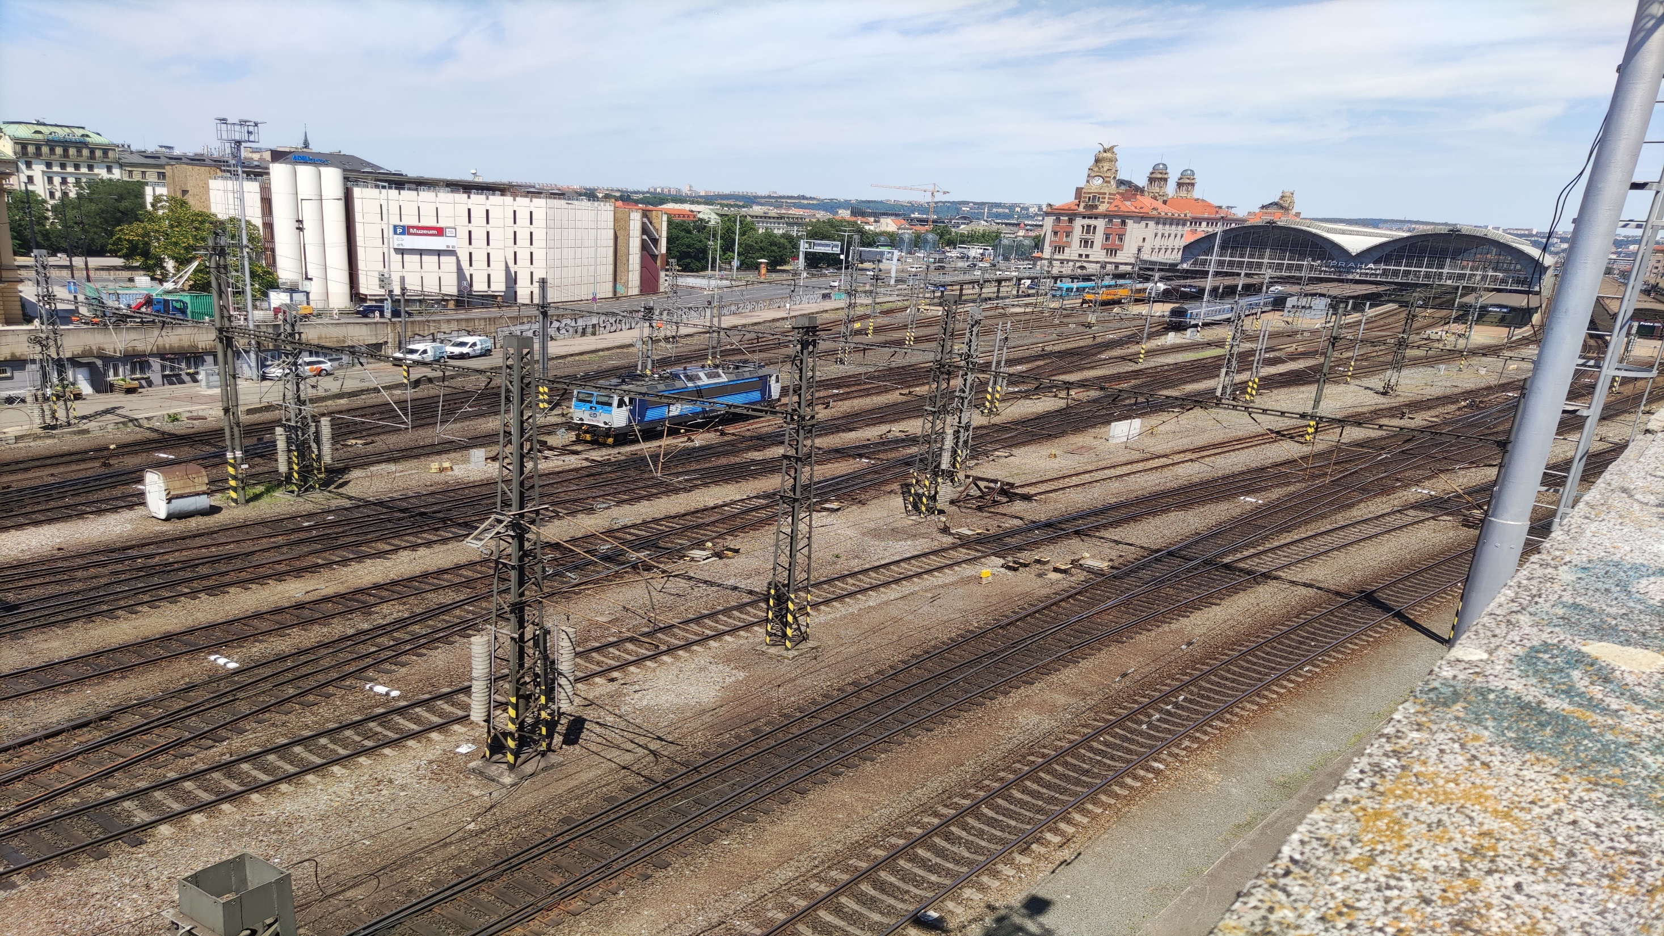
ERASMUS + studentska mobilnost Prag 2023.
ERASMUS + student mobility Prague 2023.
Miloš Milanović

Slide 2
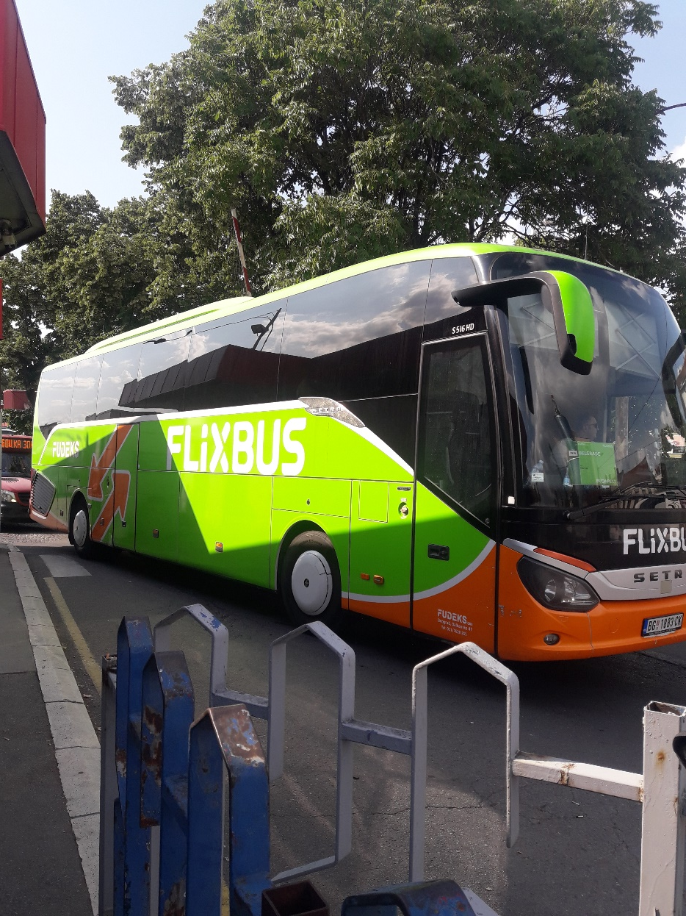
Polazak na put The journey begins

Slide 3
Dolazak u mesto boravka Arrival at the place of accommodation

Slide 4
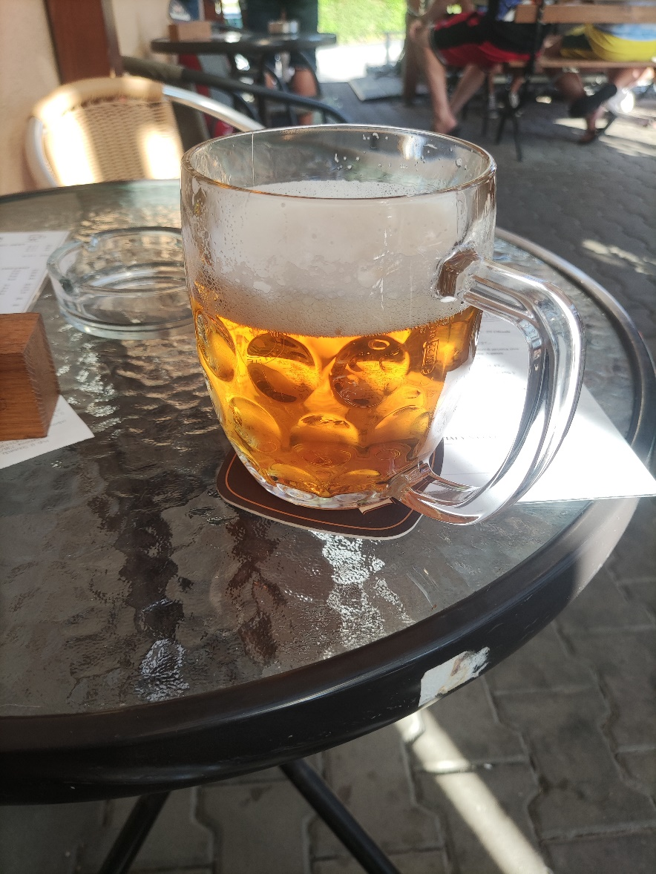
Dolazak u mesto boravka Arrival at the place of accommodation

Slide 5
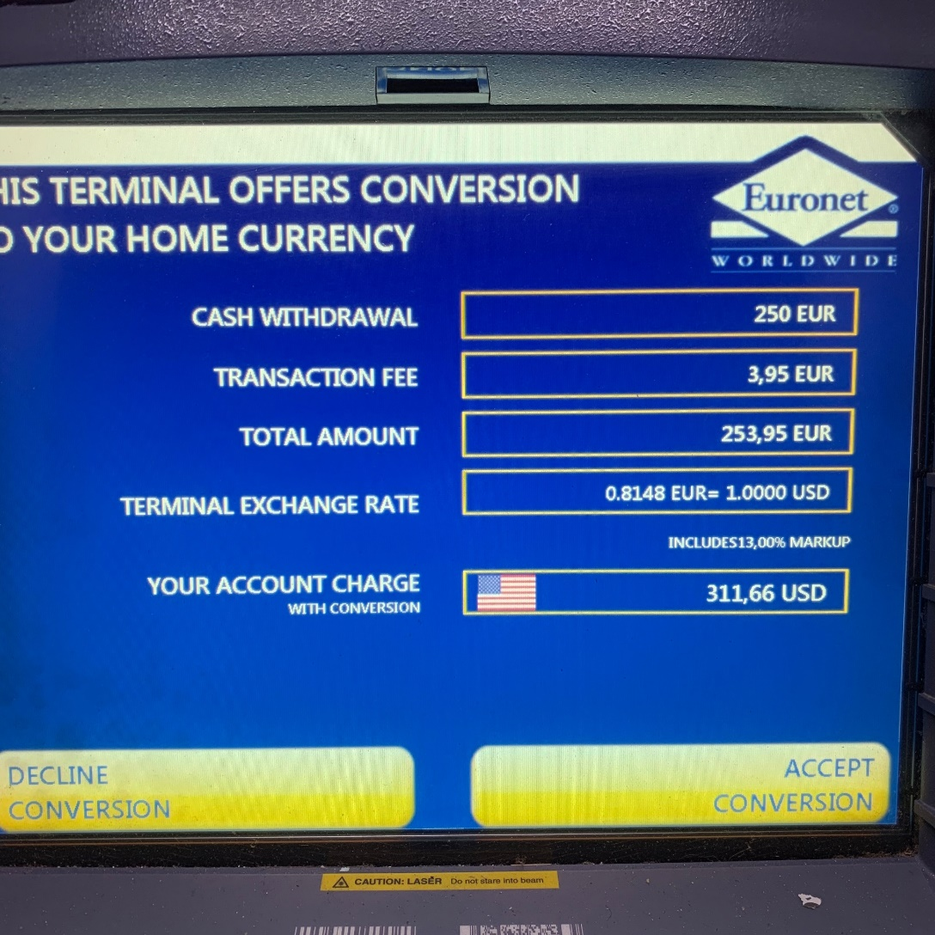
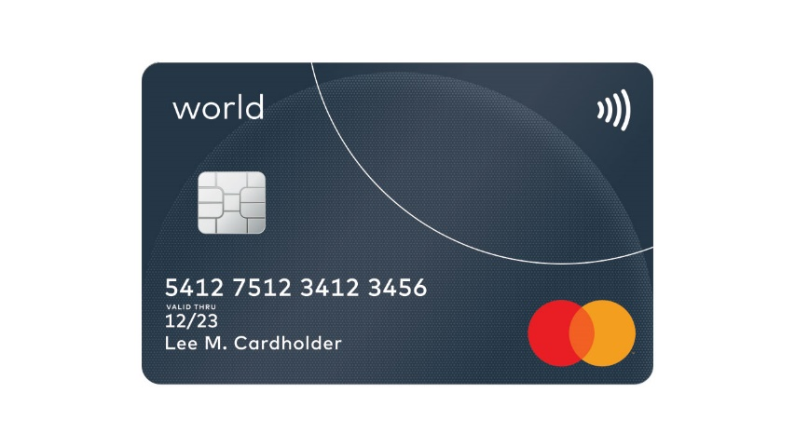
Plaćanja, menjanje novca, bankomati Paying, money exchange, ATM-s

Slide 6
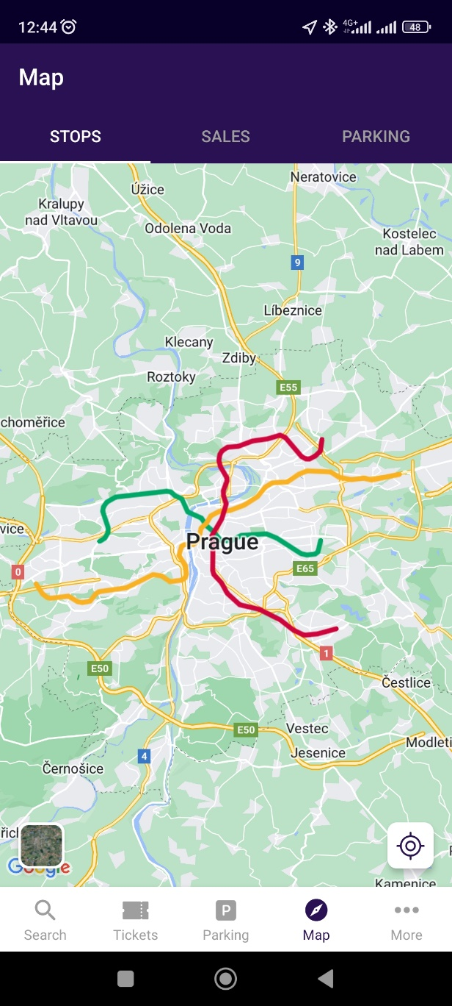
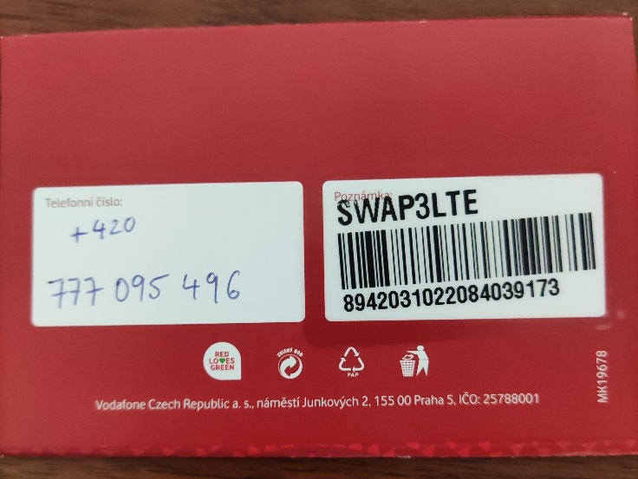
Što pre srediti Things to do ASAP
Kartica za telefon / Internet
Karta za prevoz i mape
Aplikacije

Slide 7
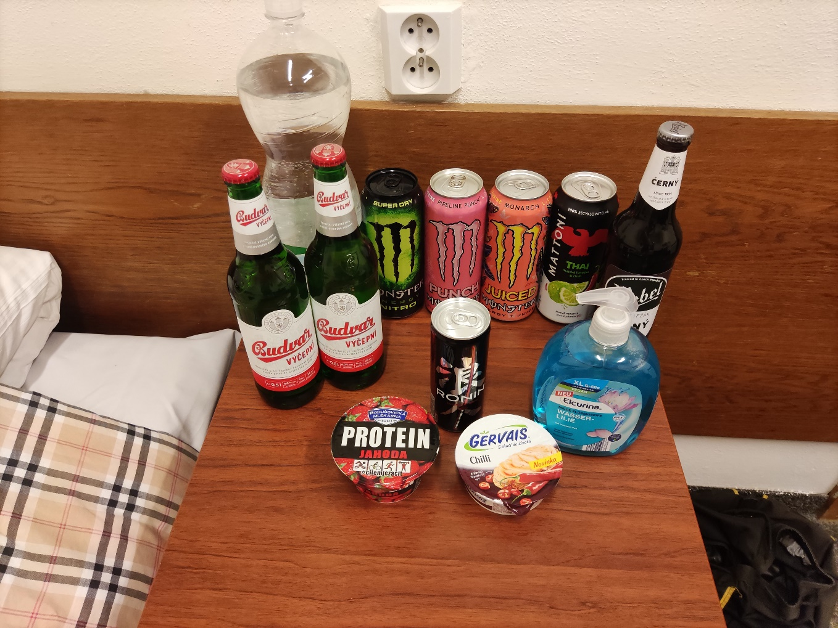
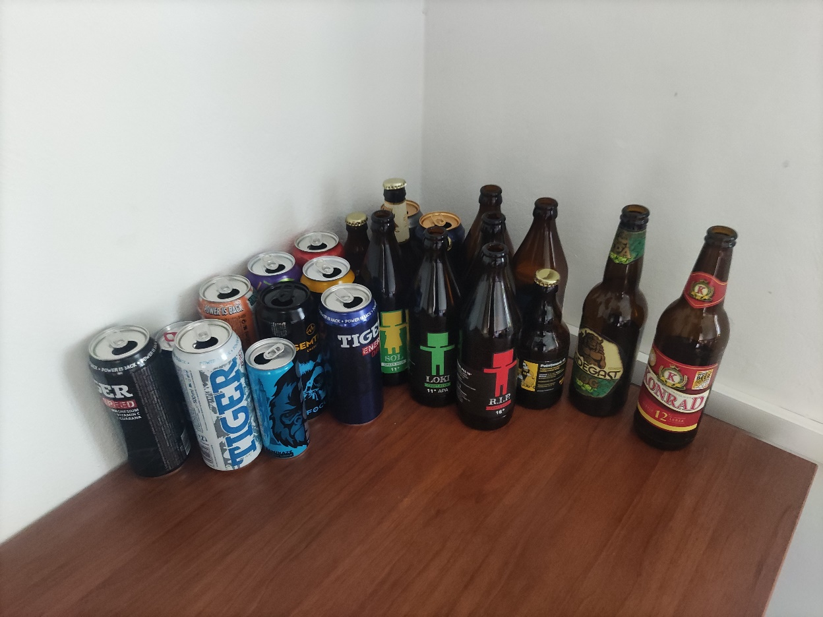
Studentska potrošačka korpa Students shopping list

Slide 8
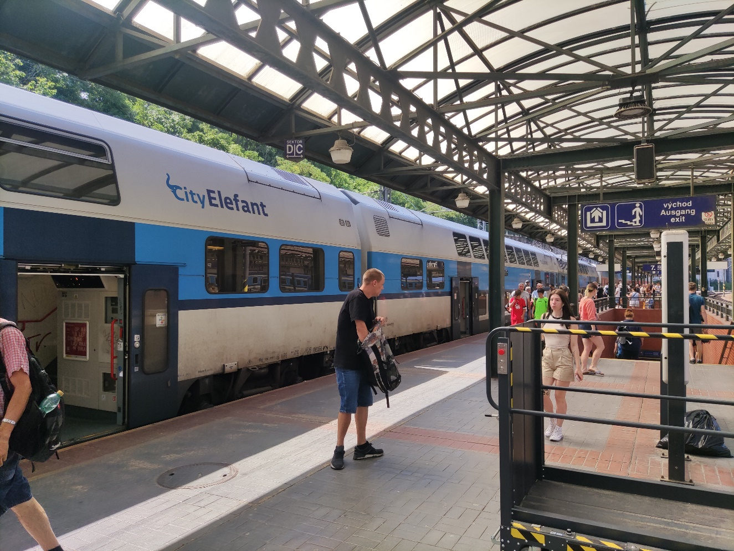
Gradski prevoz City transportation

Slide 9
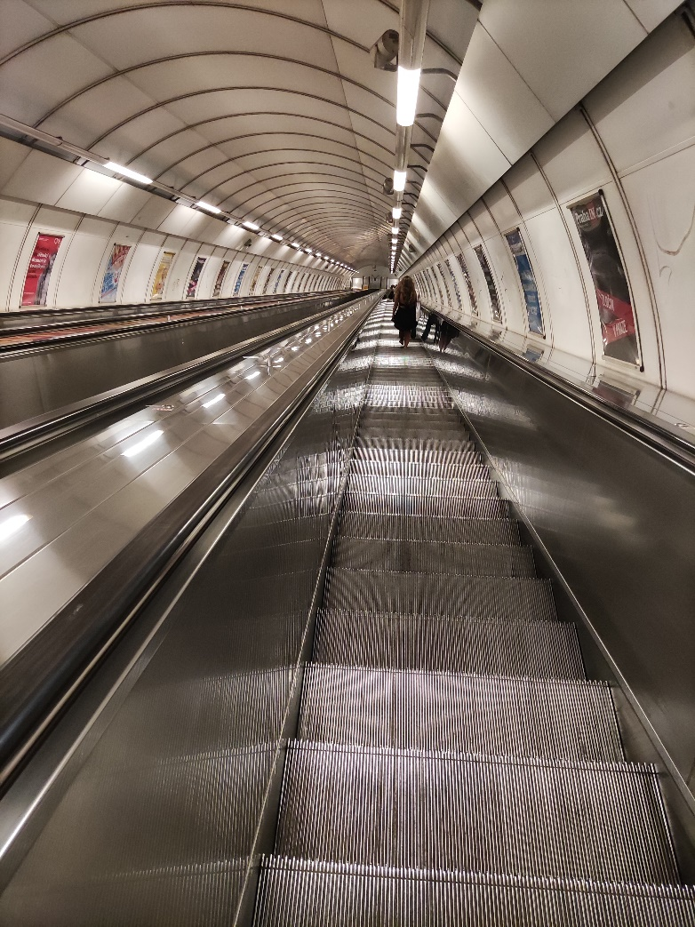
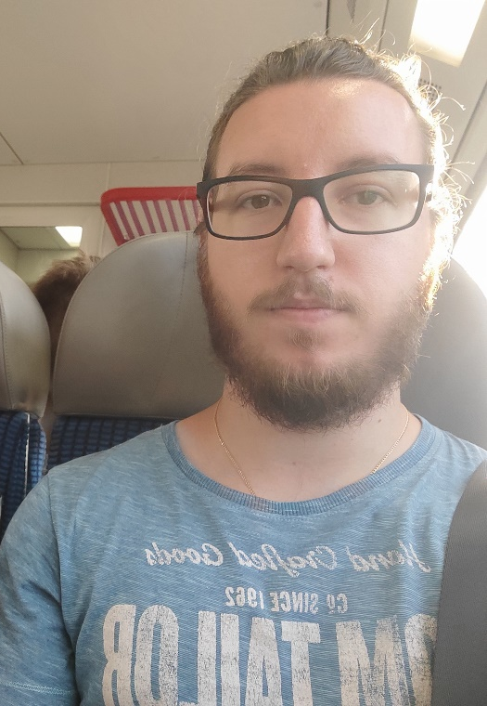
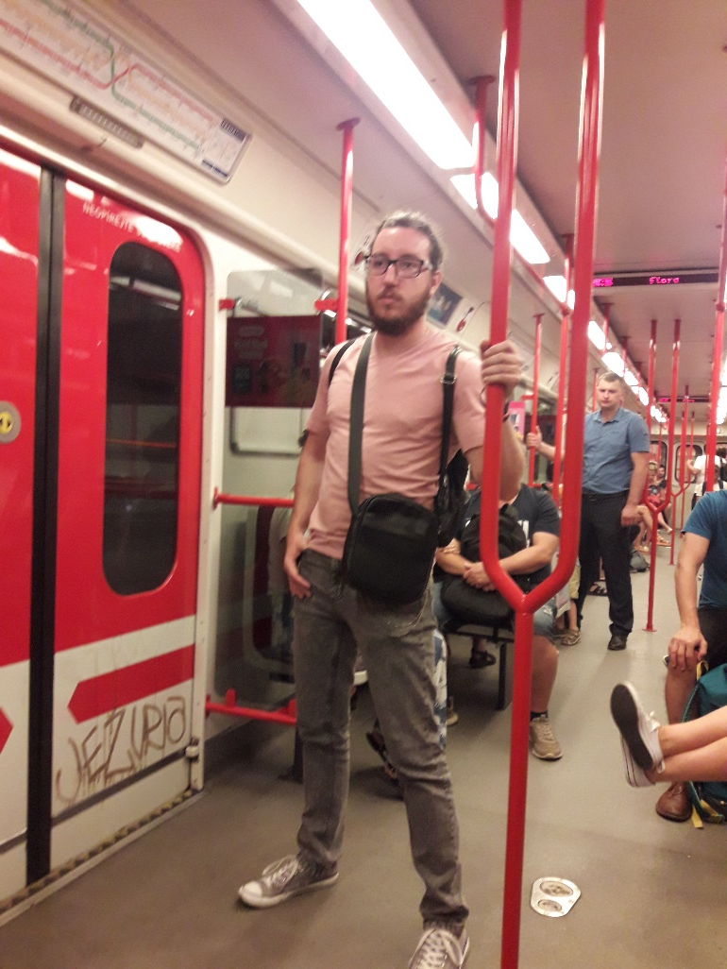
Gradski prevoz City transportation

Slide 10
AŽD Praha We have only just begun

Slide 11
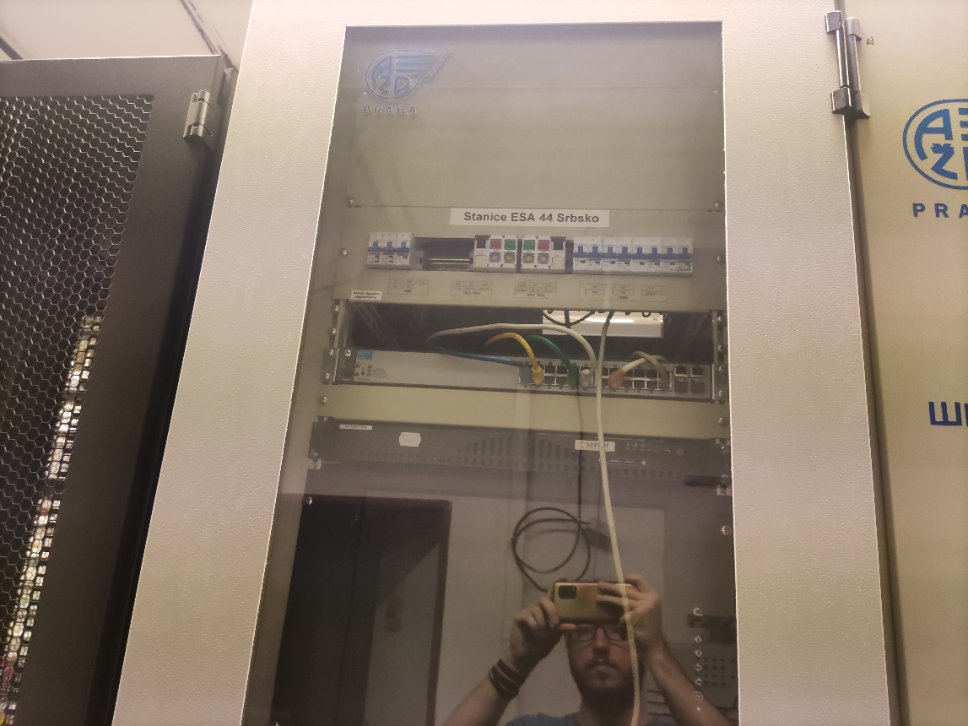
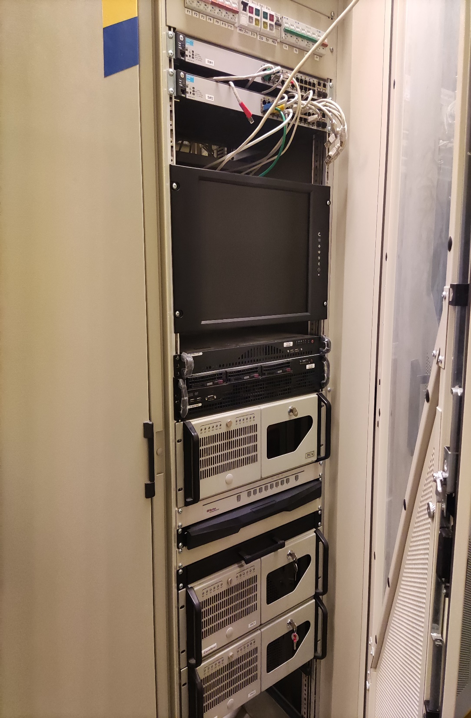
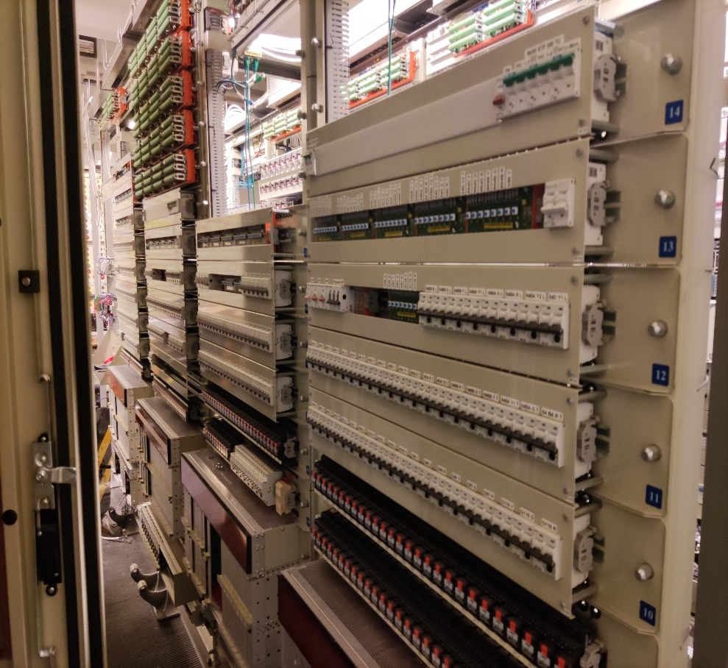
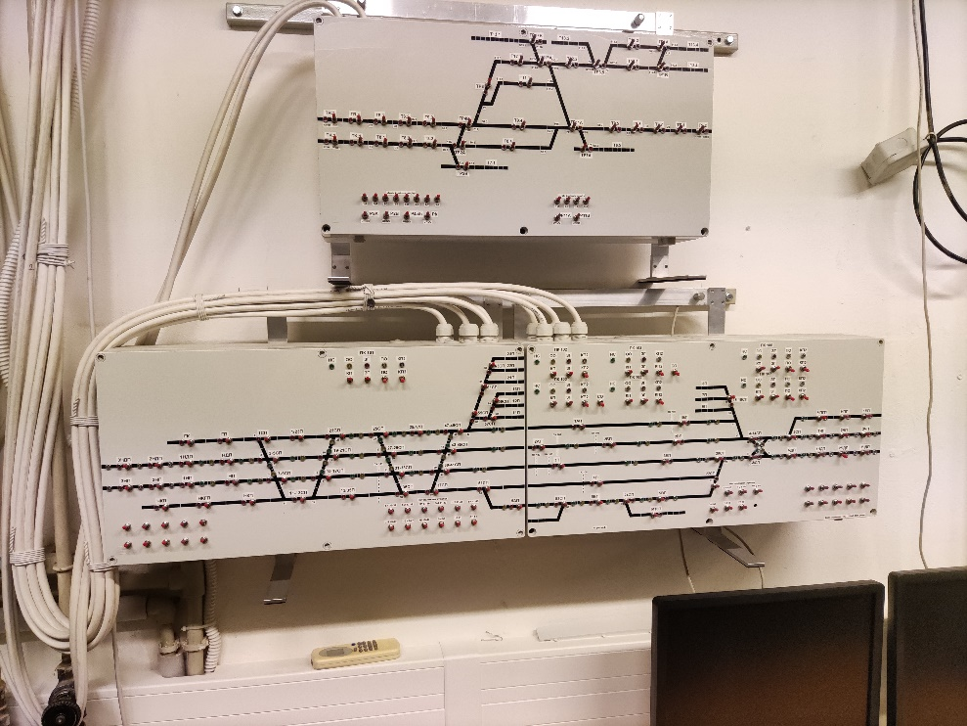
Obilazak kompanije Tour of the company

Slide 12
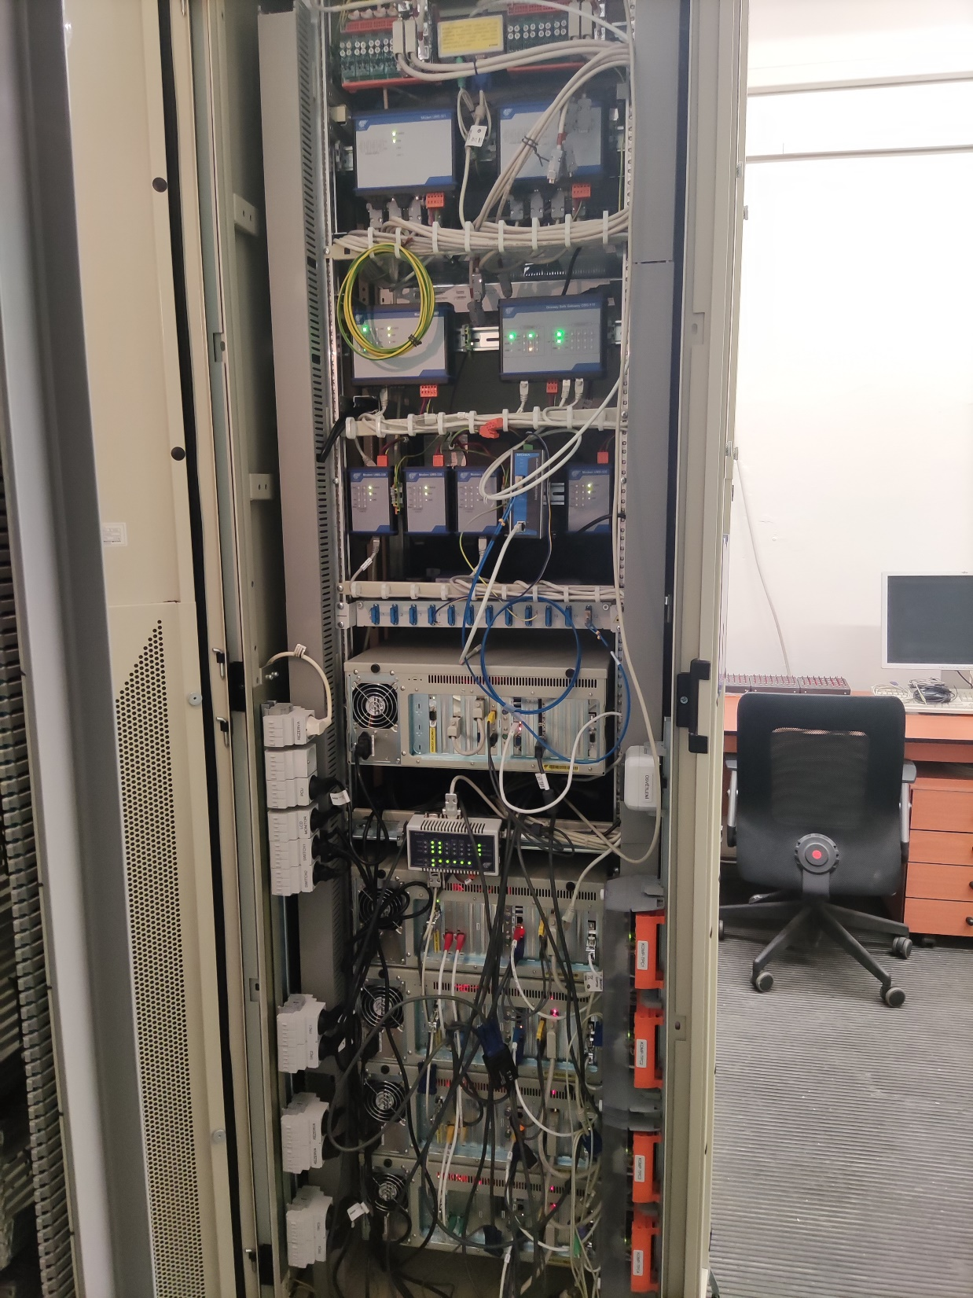
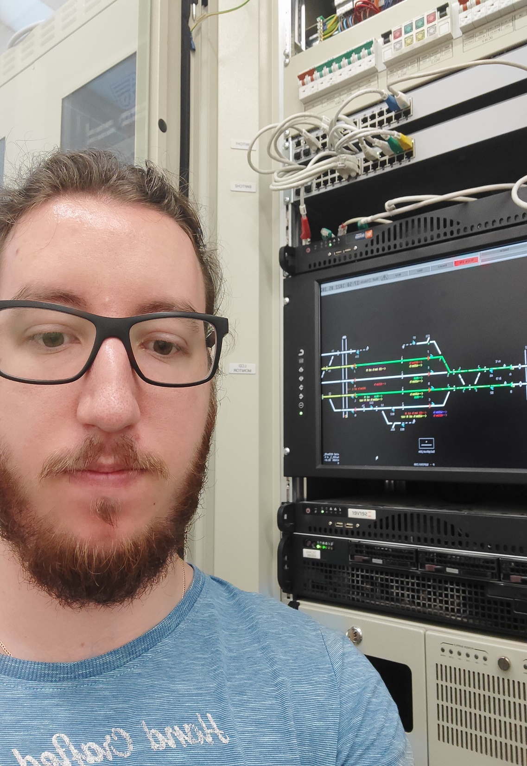
Obilazak kompanije Tour of the company

Slide 13
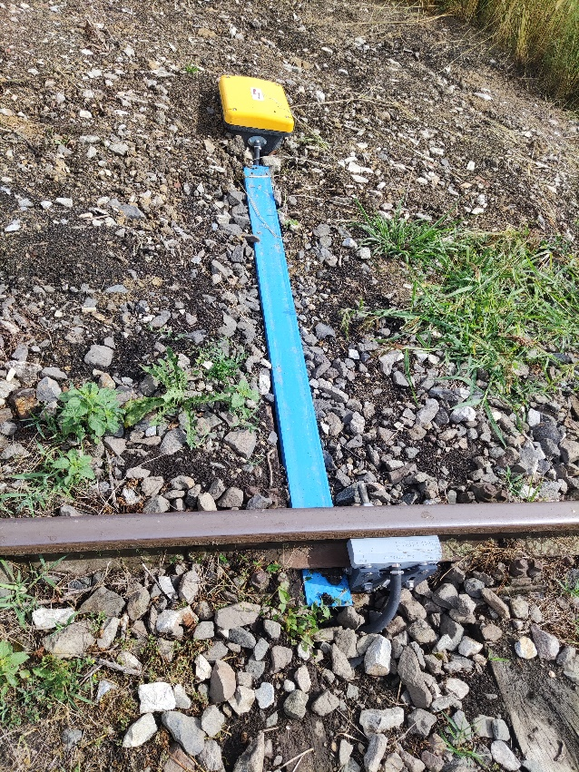
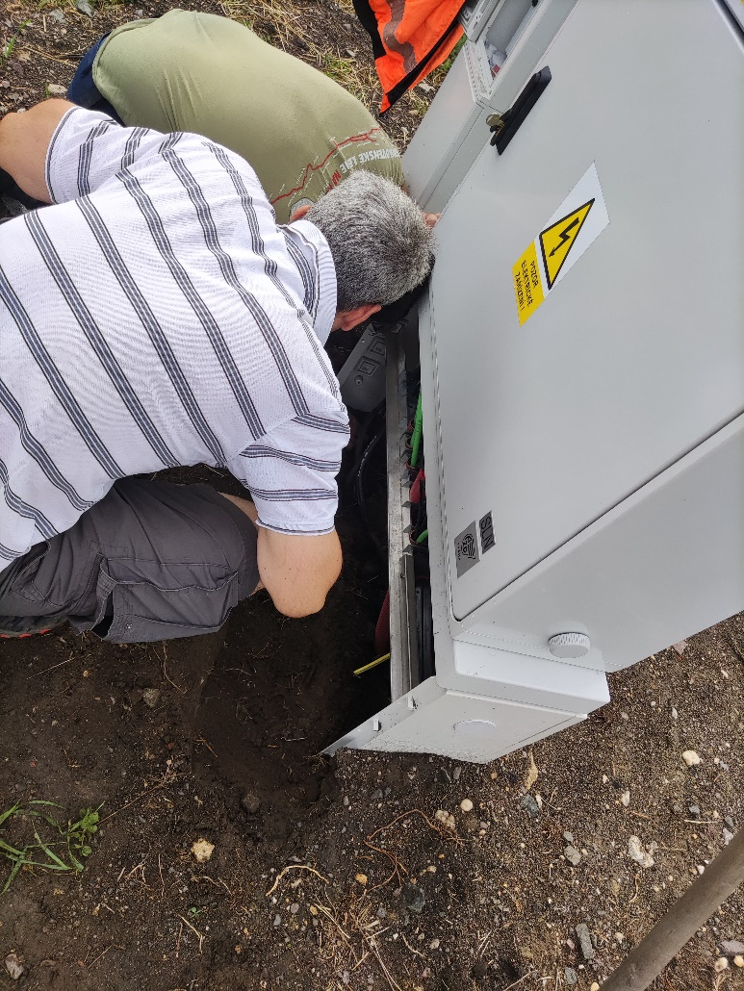
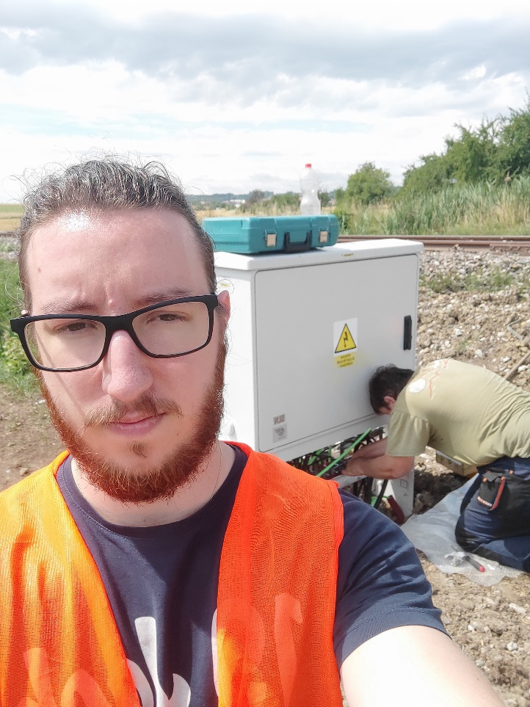
Izlazak na teren Out in the field

Slide 14
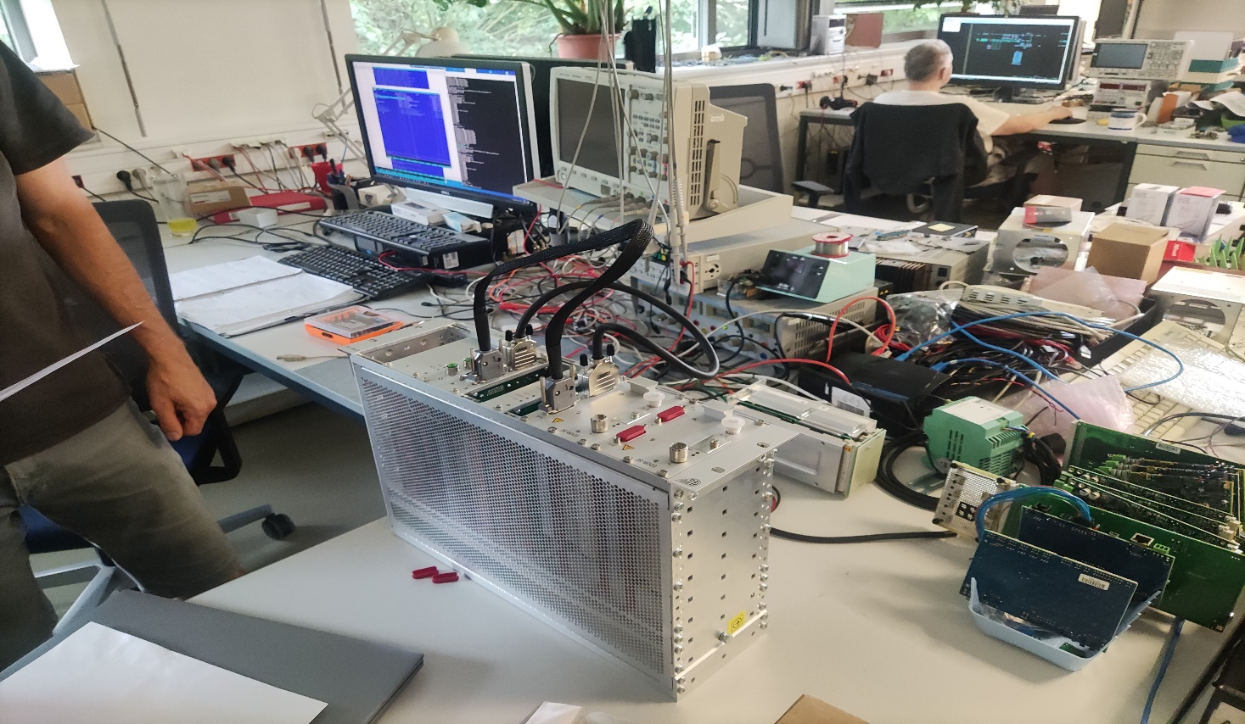
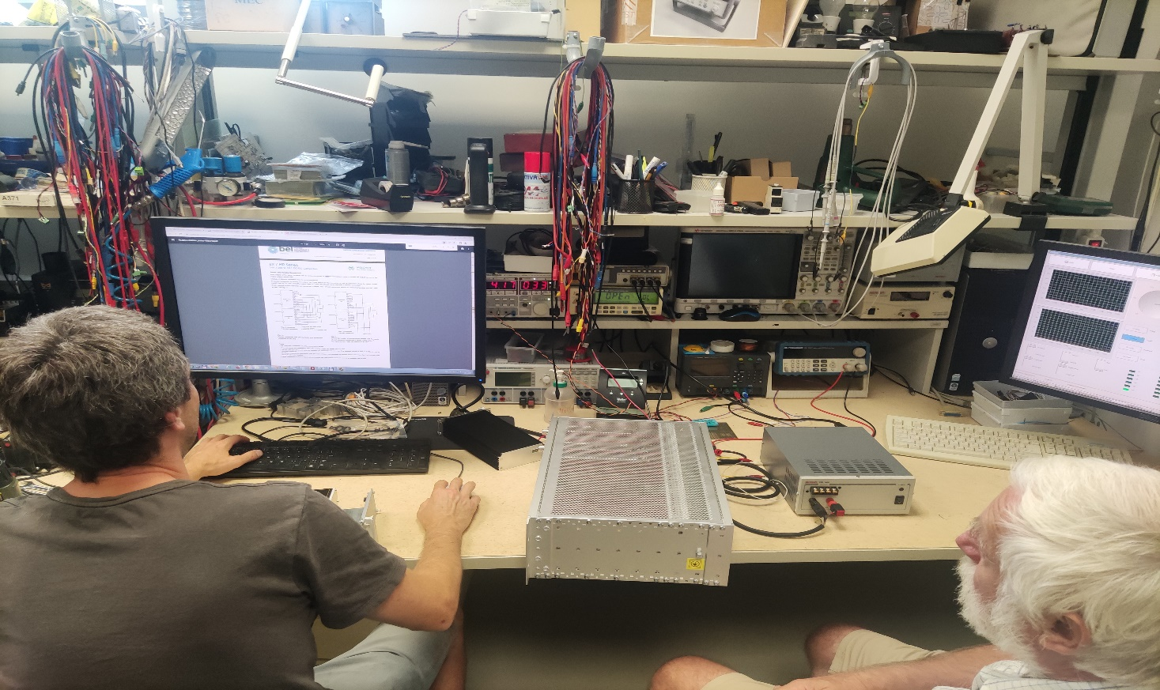
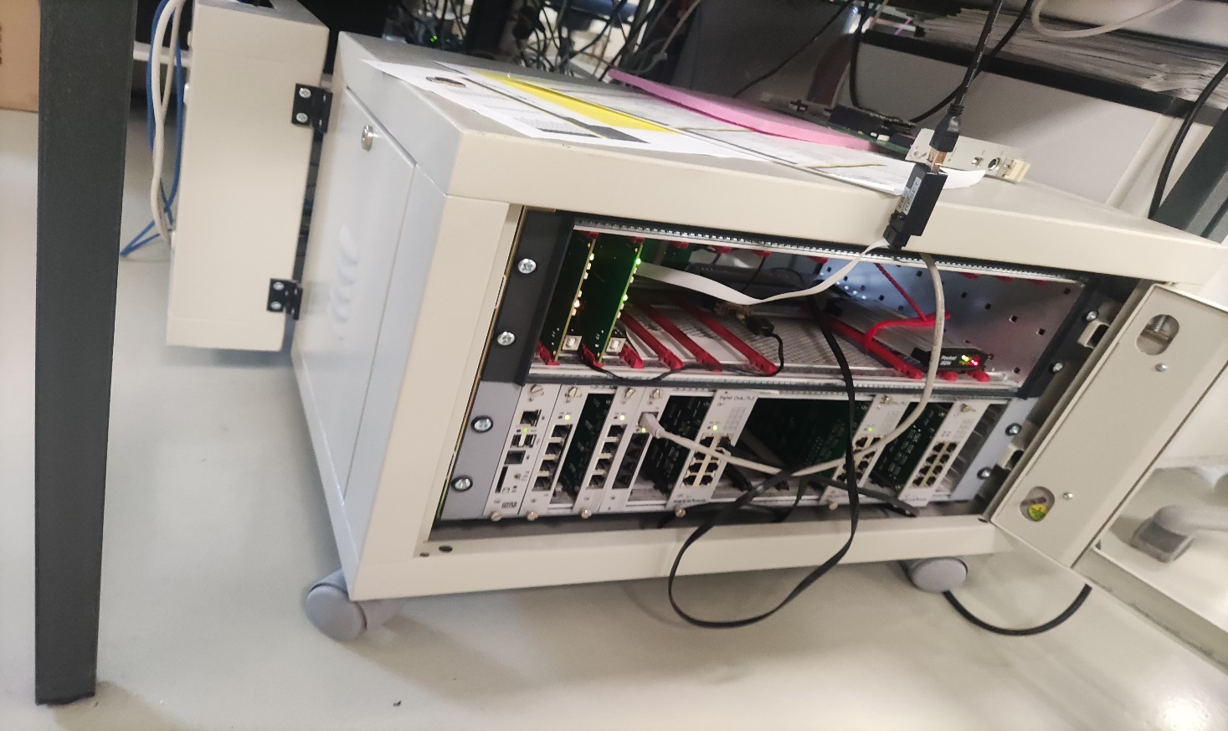
Popravke i dijagnostika Repairs and diagnostics

Slide 15
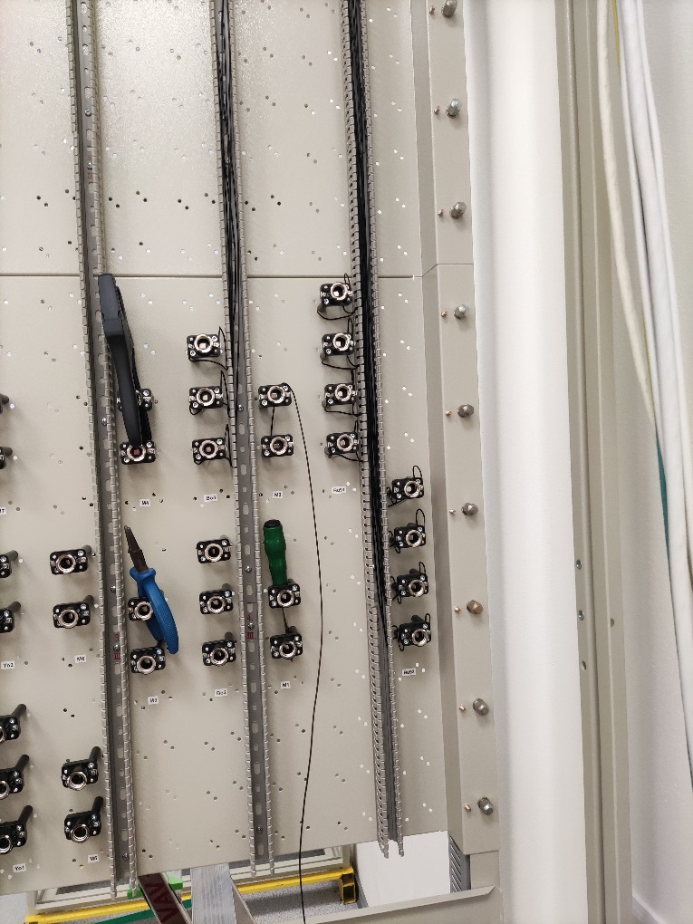
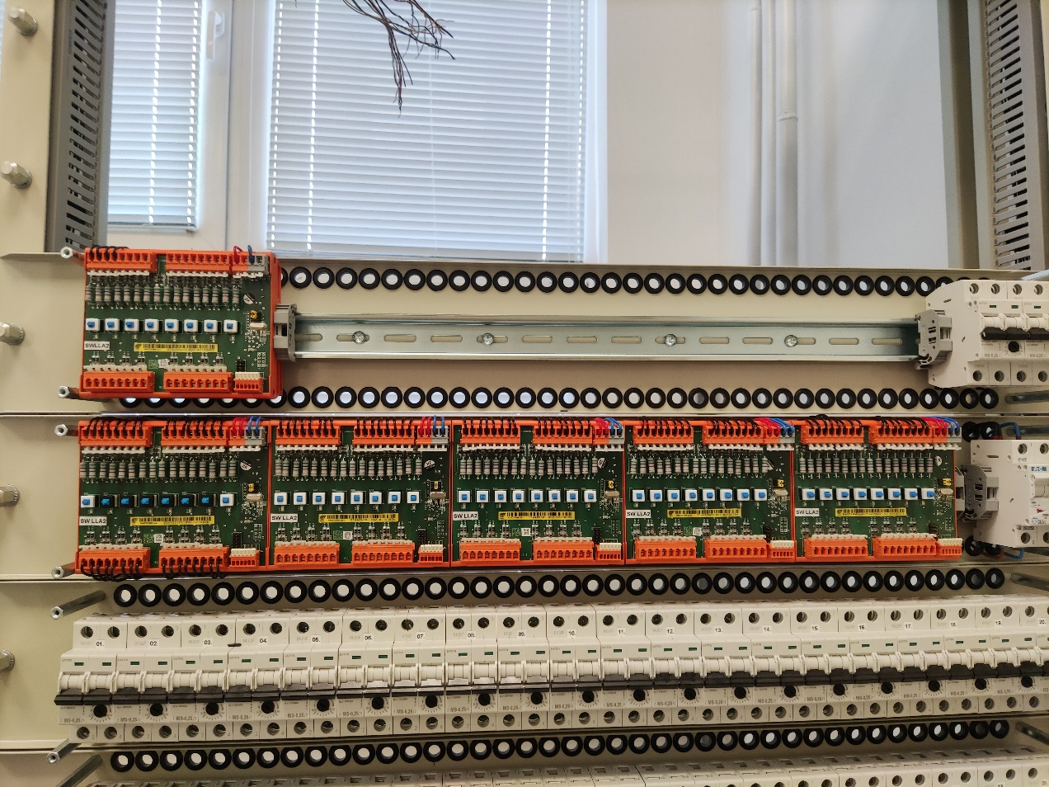
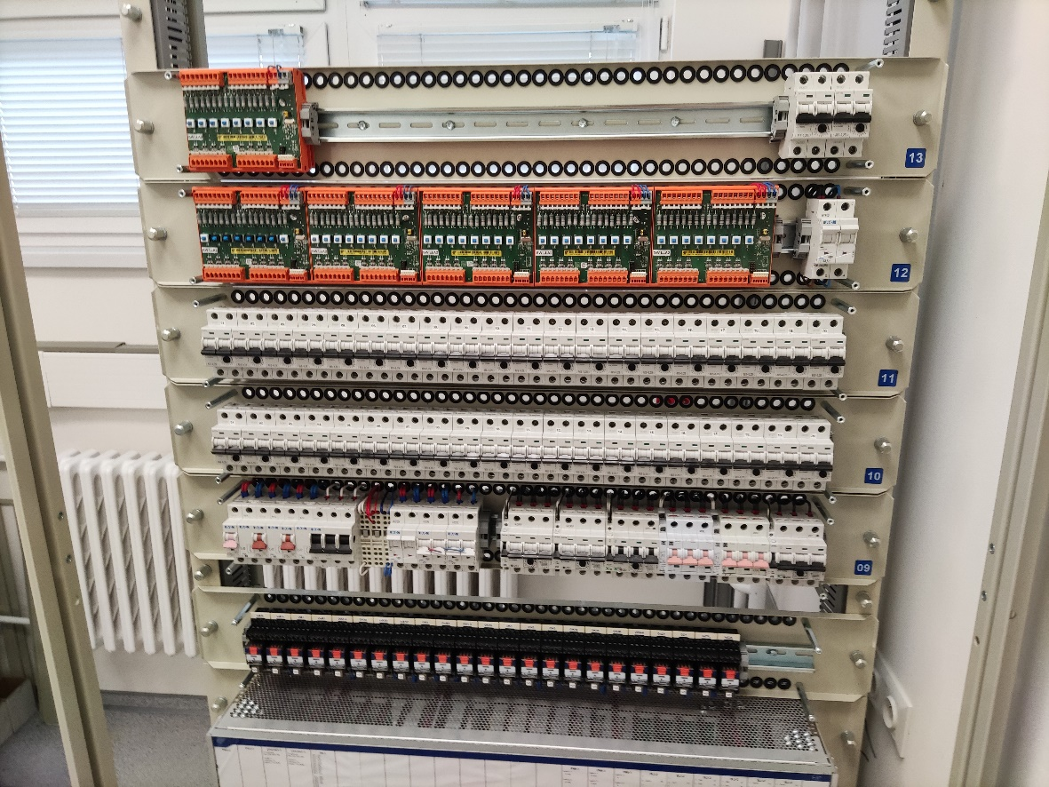
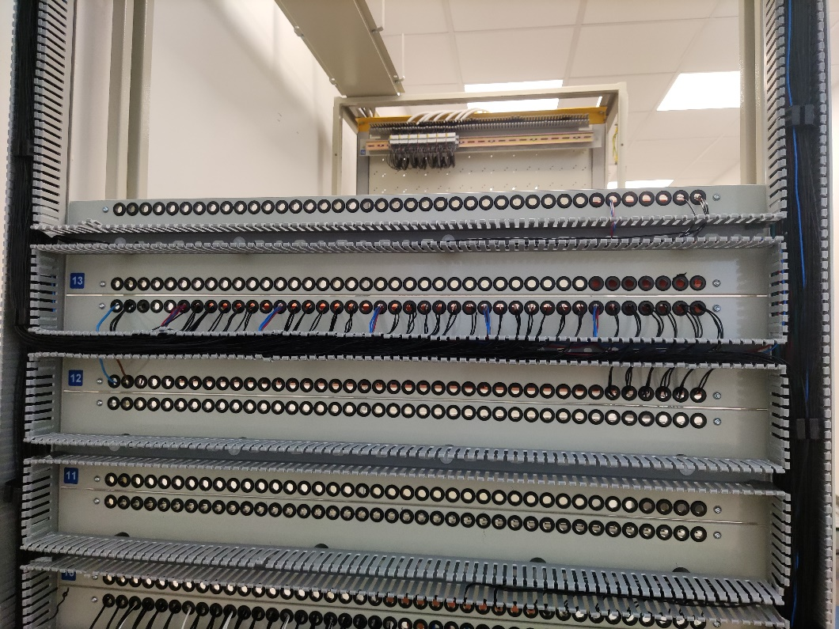
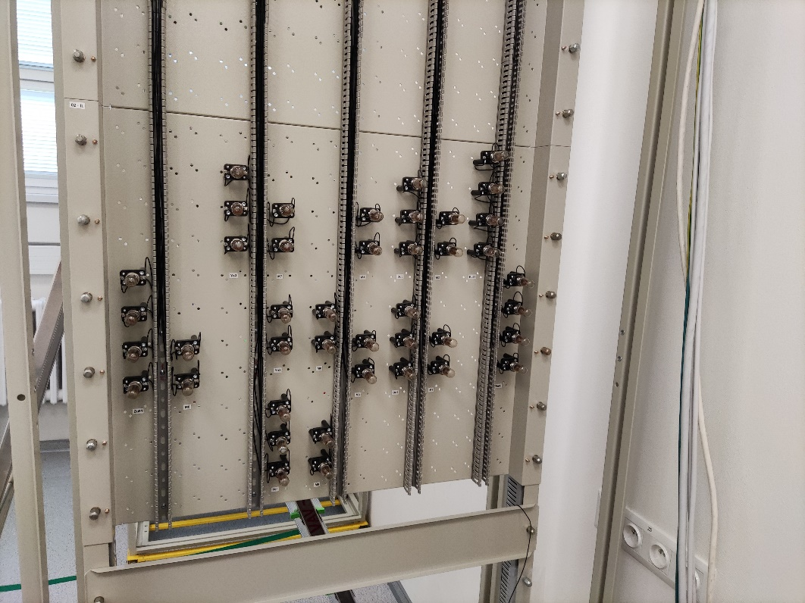
Poligon Do it yourself

Slide 16
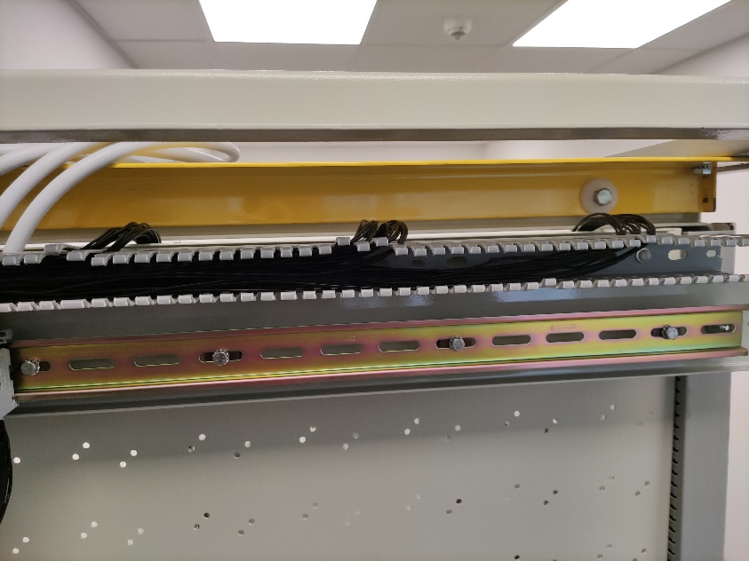
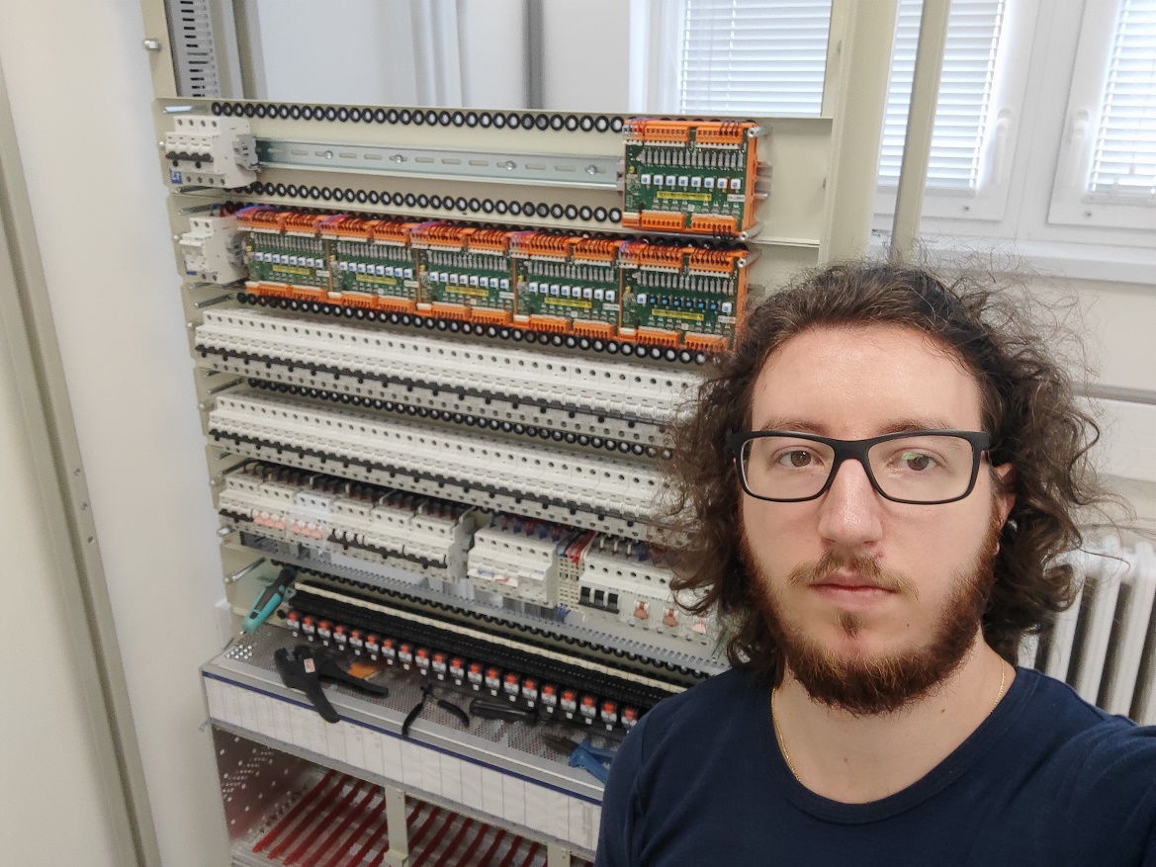
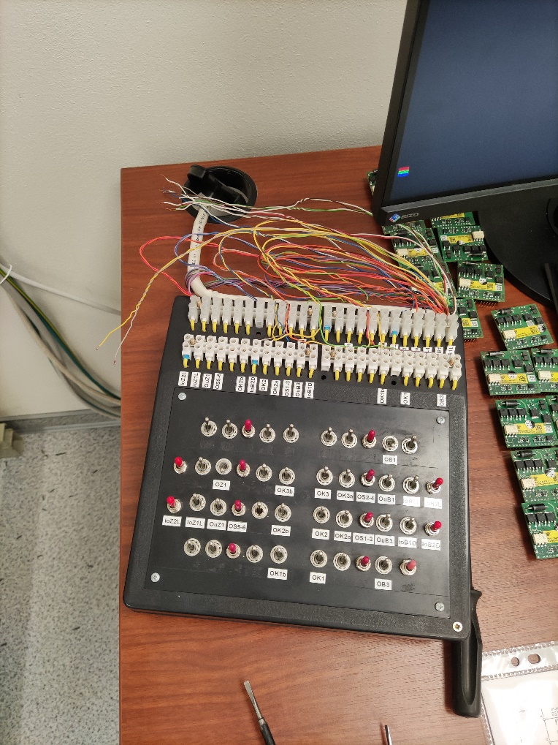
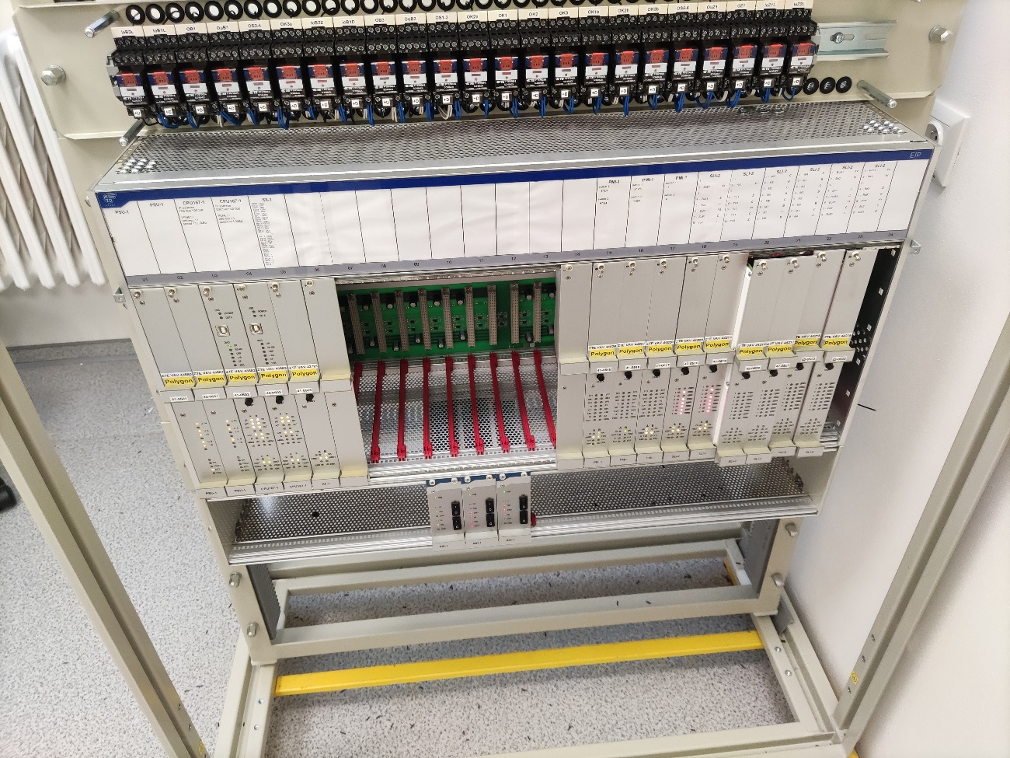
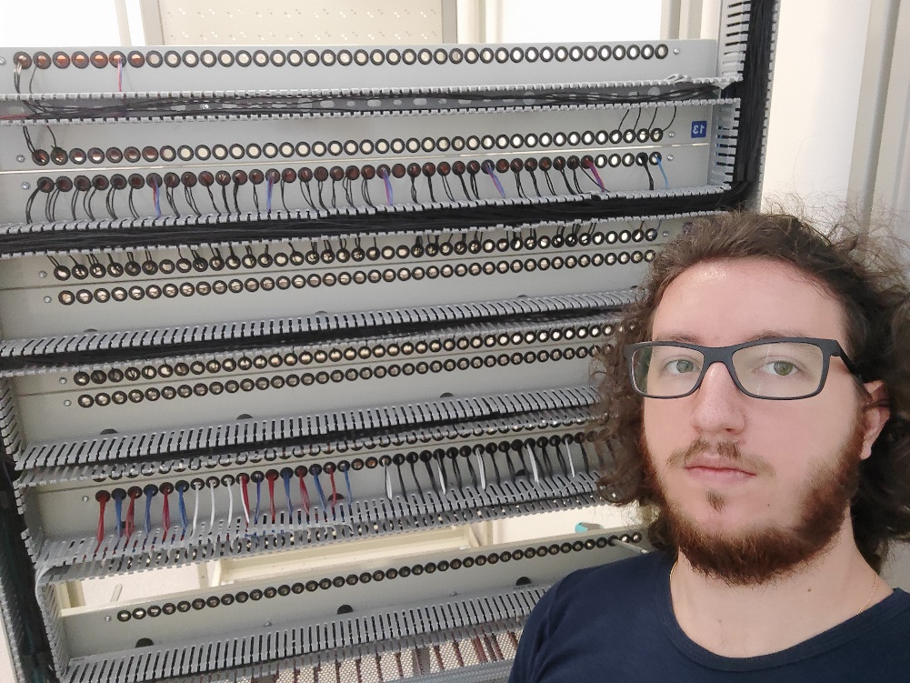
Poligon Do it yourself

Slide 17
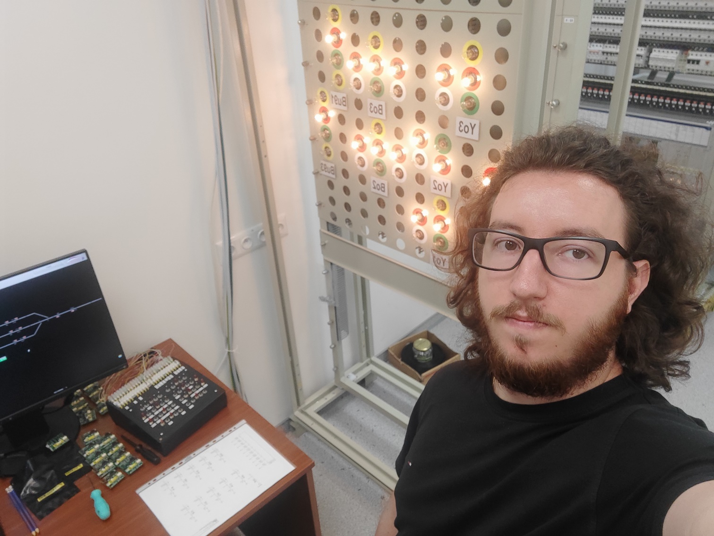
Poligon End product

Slide 18
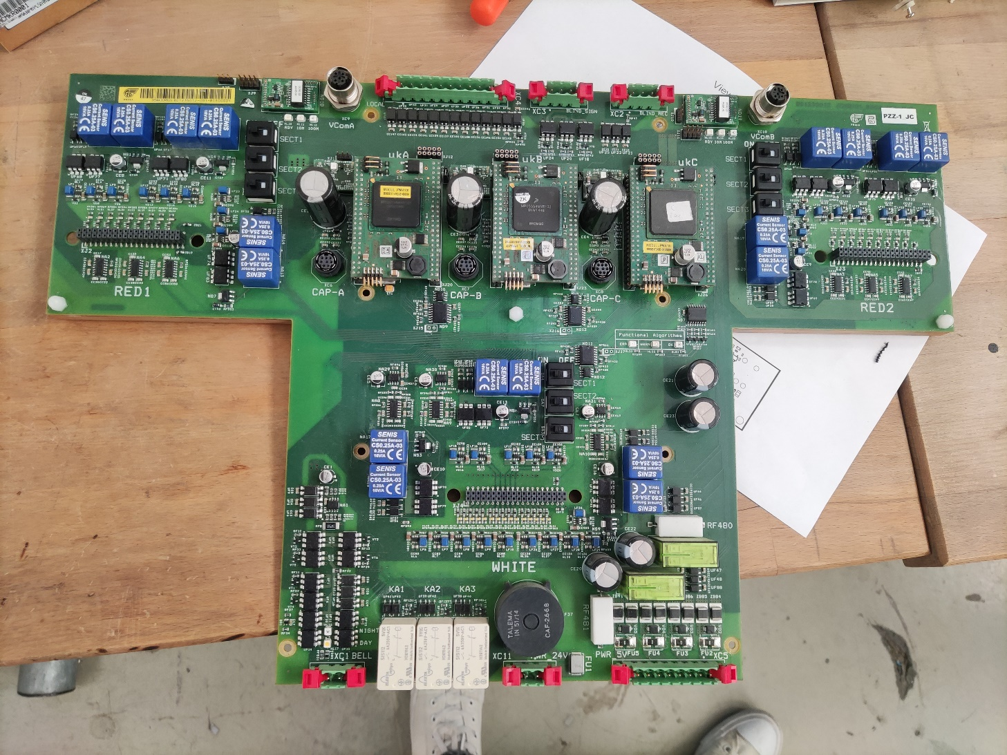
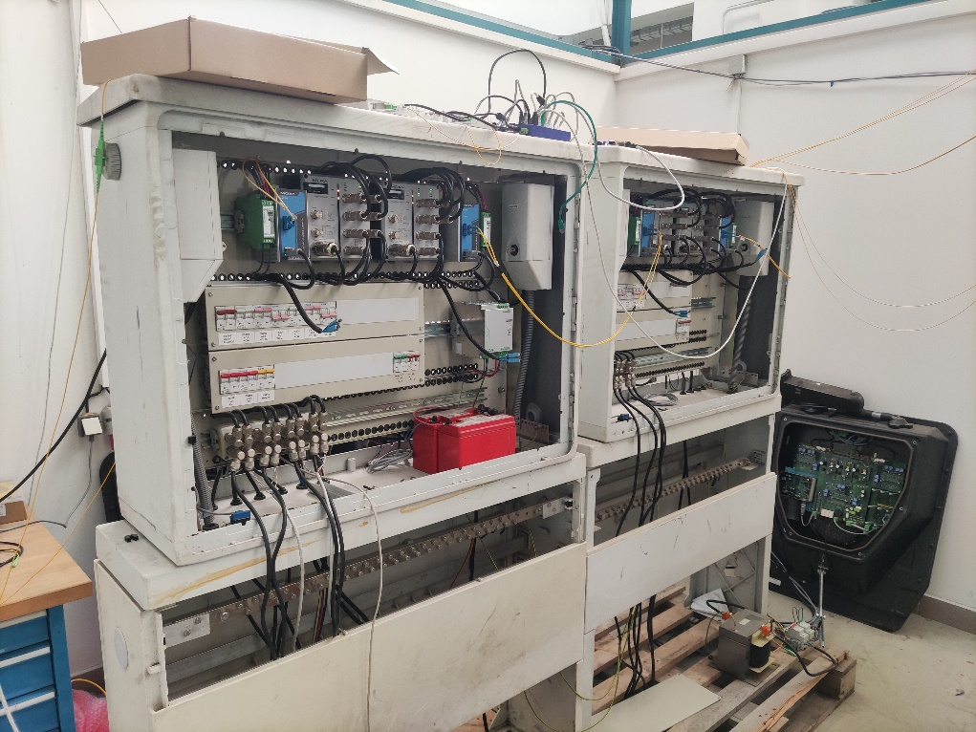
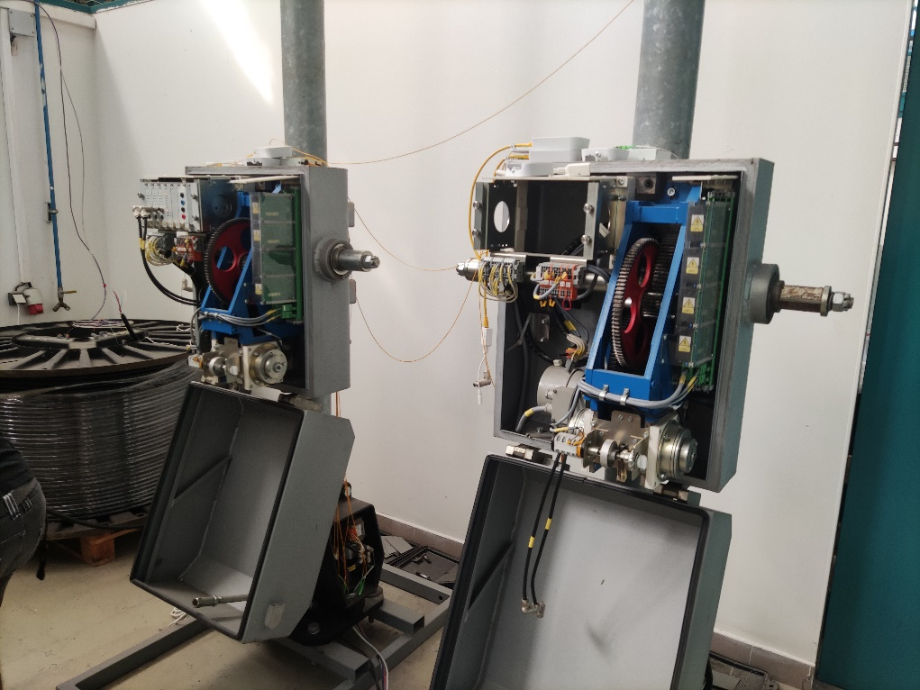
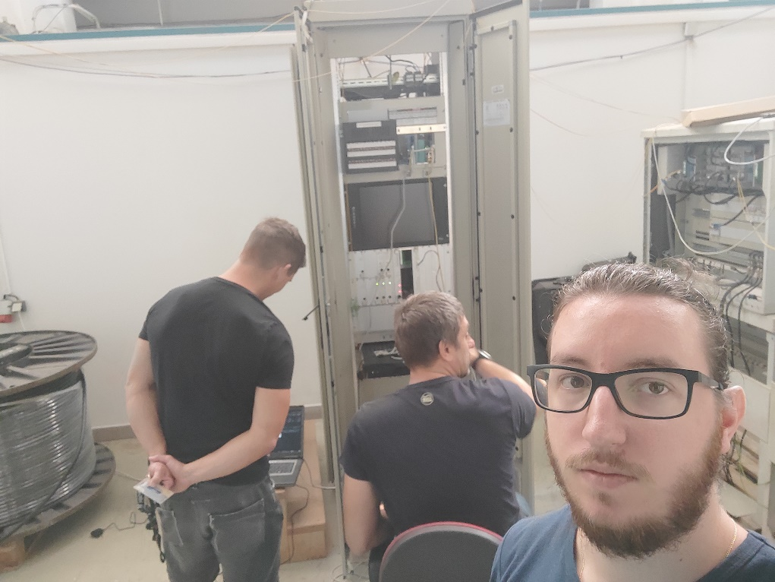
Pruga za vozove bez vozača – u pripremi Driverless track – work in progress

Slide 19
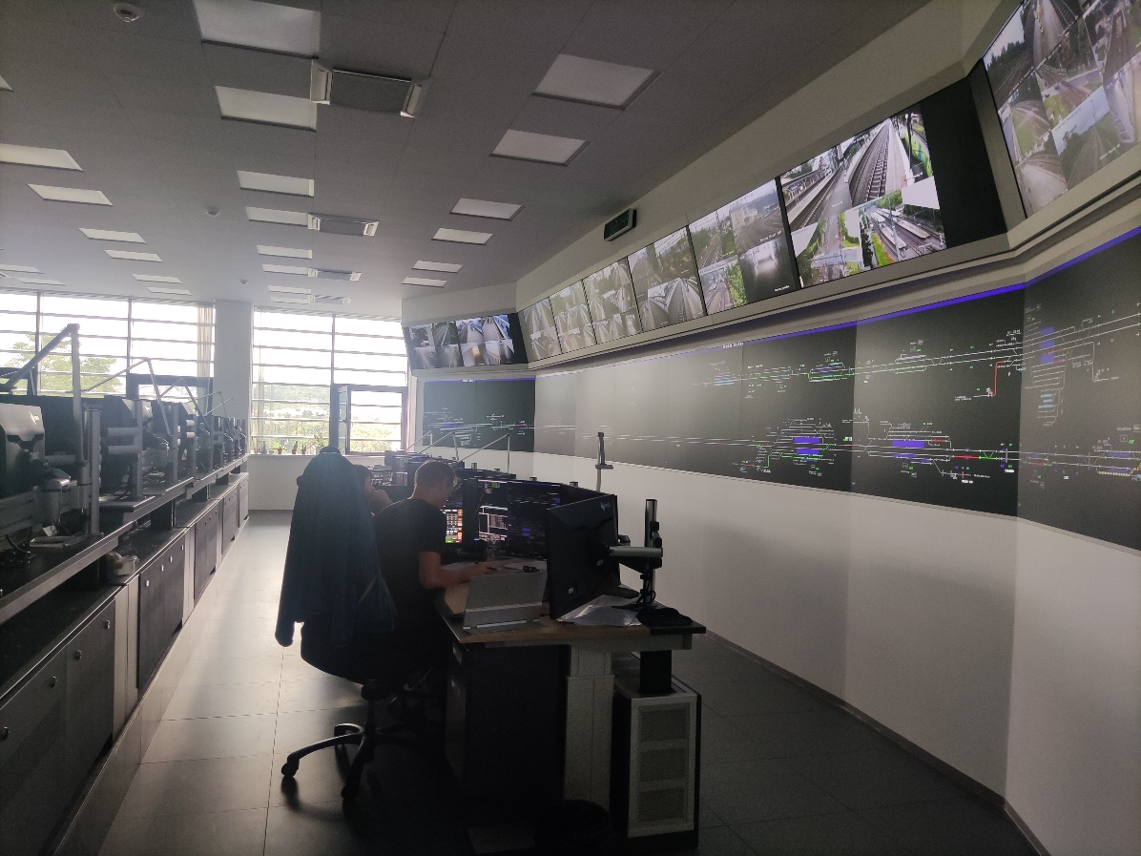
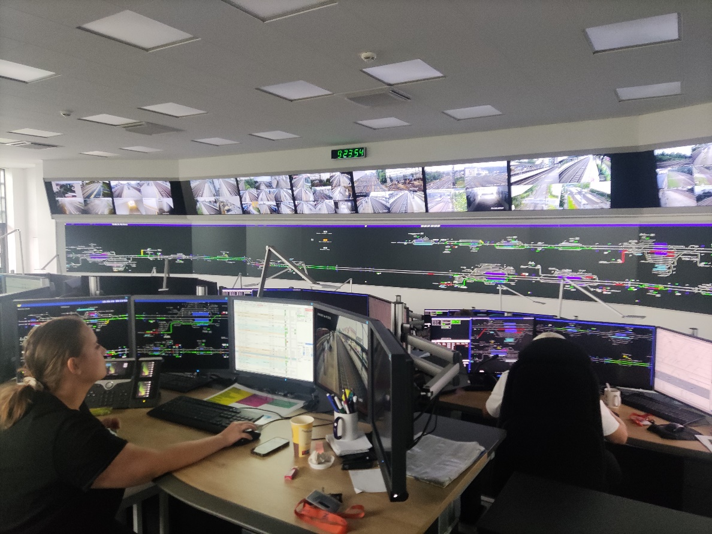
Poseta CDP-u Visit to CDP

Slide 20
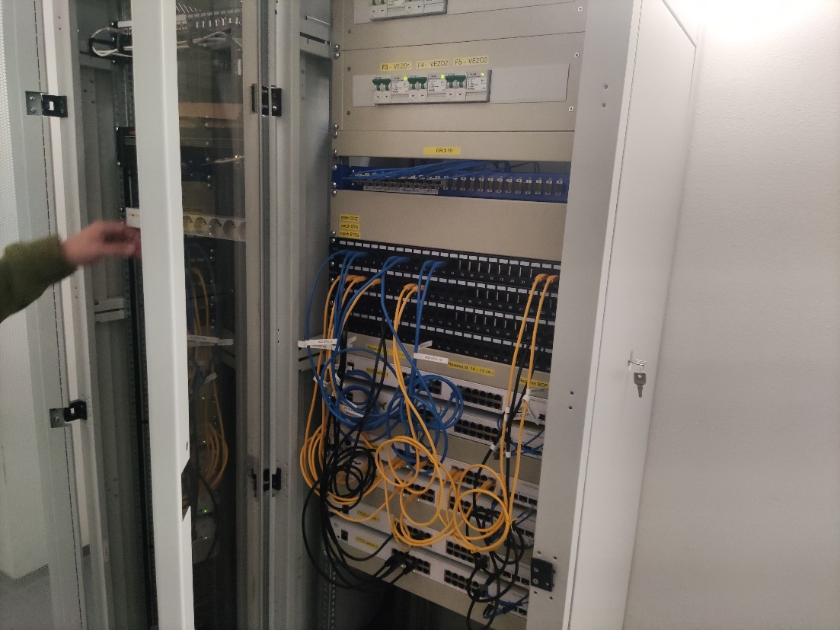
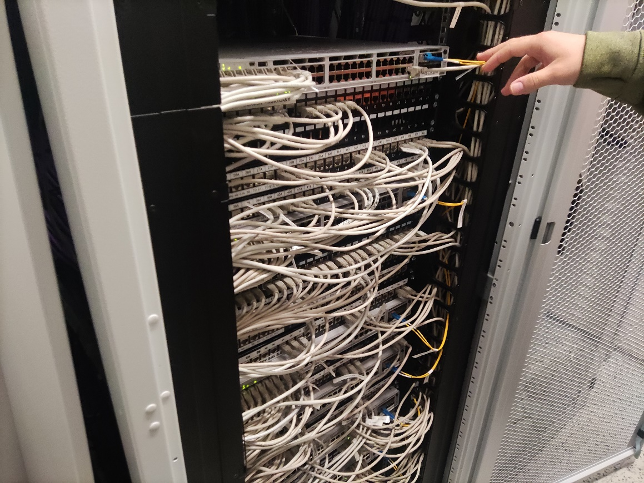
Poseta CDP-u Visit to CDP

Slide 21
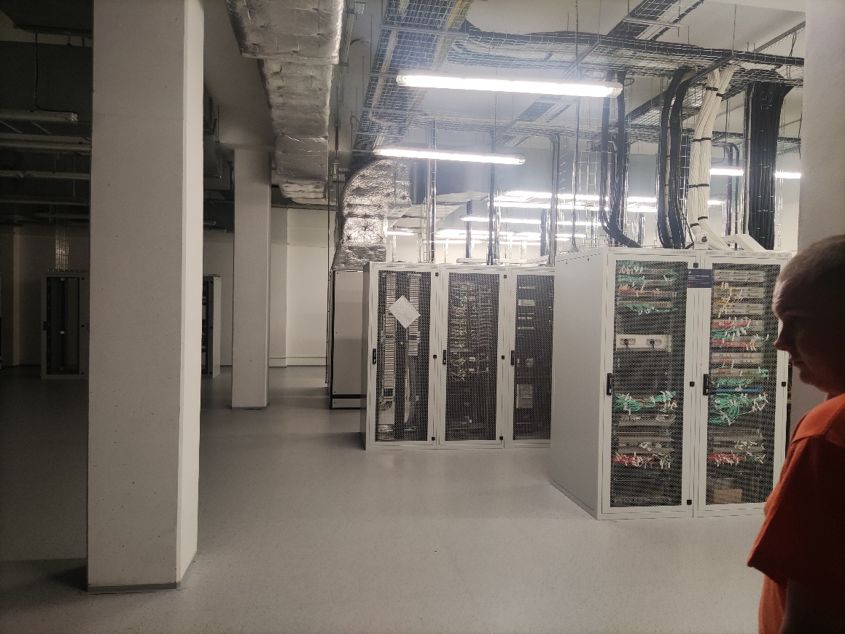
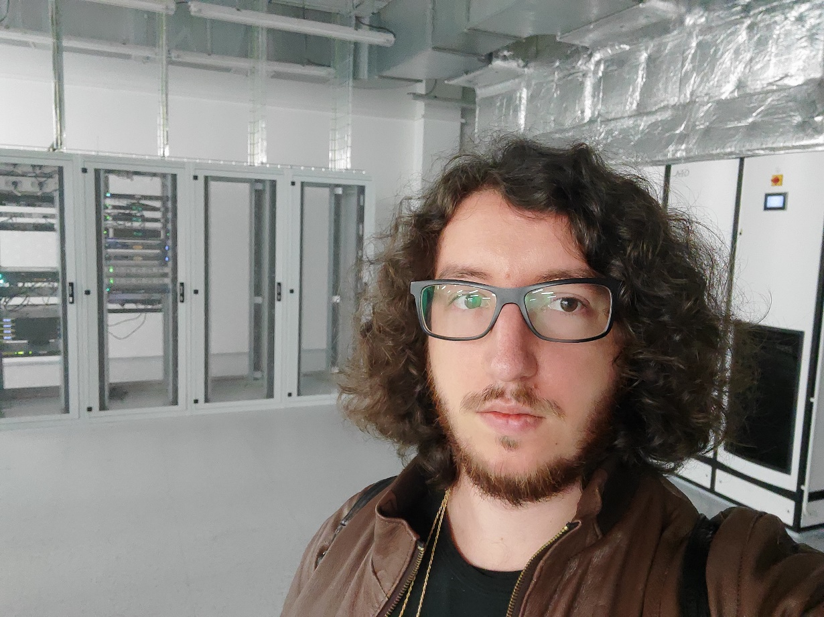
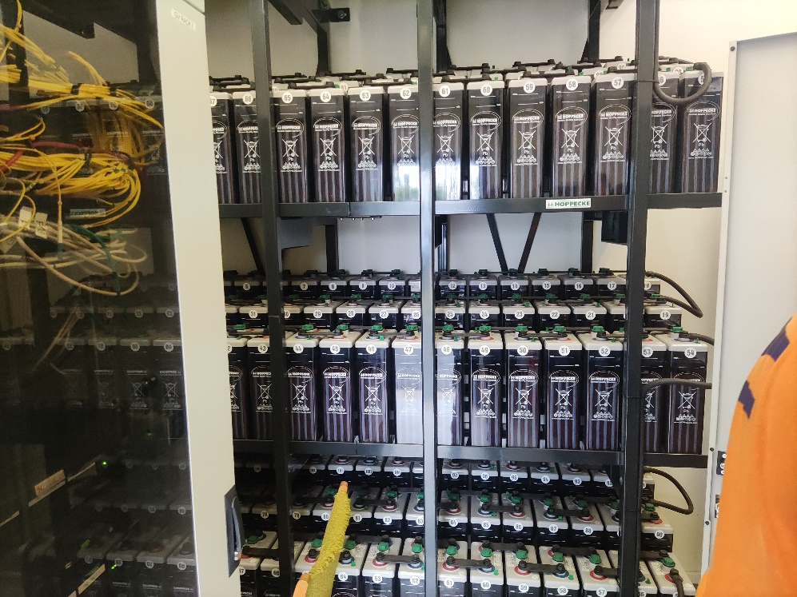
Poseta CDP-u Visit to CDP

Slide 22
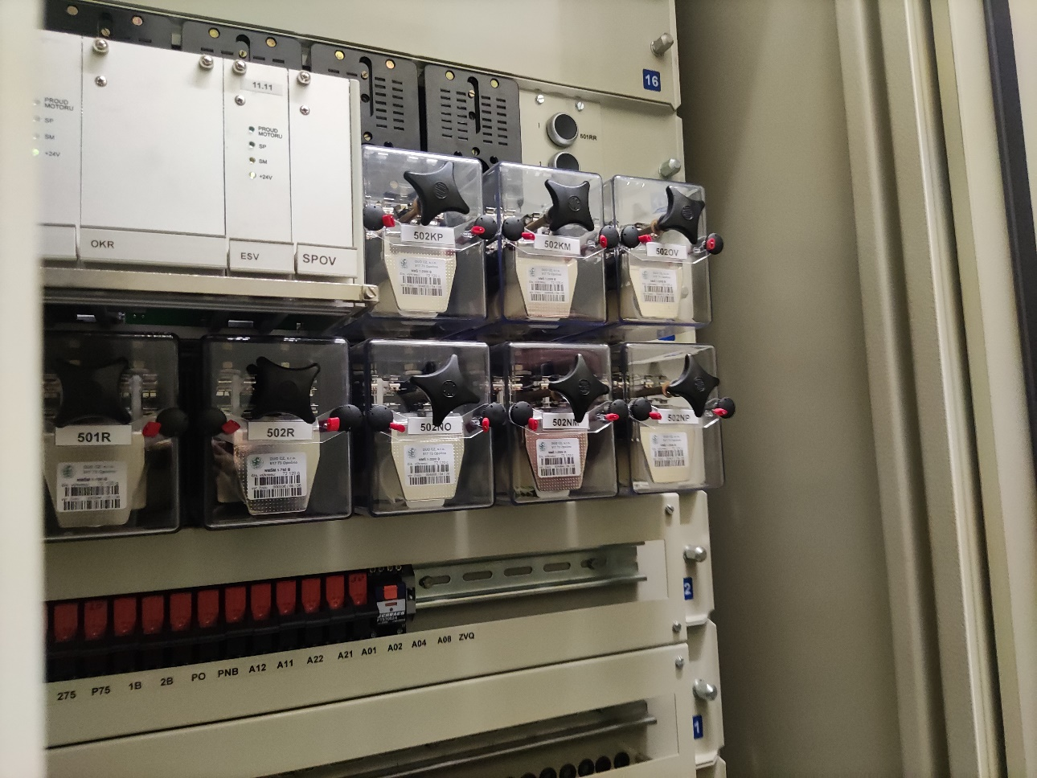
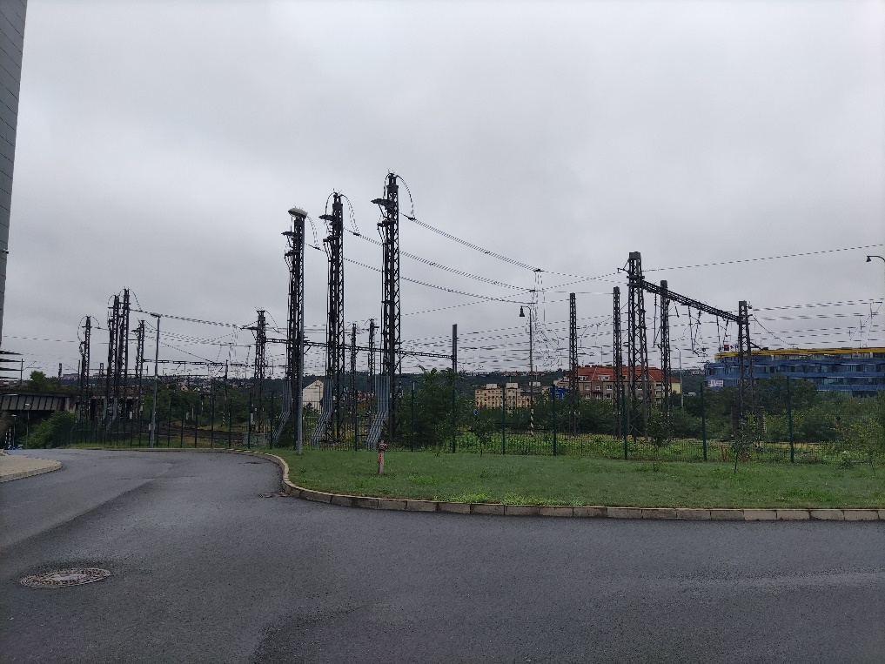
Poseta CDP-u Visit to CDP

Slide 23
Računarsko odeljenje, GSM-R, projektovanje, simulator Computer sector, GSM-R, system designing and planing, simulator

Slide 24
Slobodno vreme i obilasci Free time and tourism

Slide 25
Oppenheimer Now I am become death, the destroyer of worlds

Slide 26
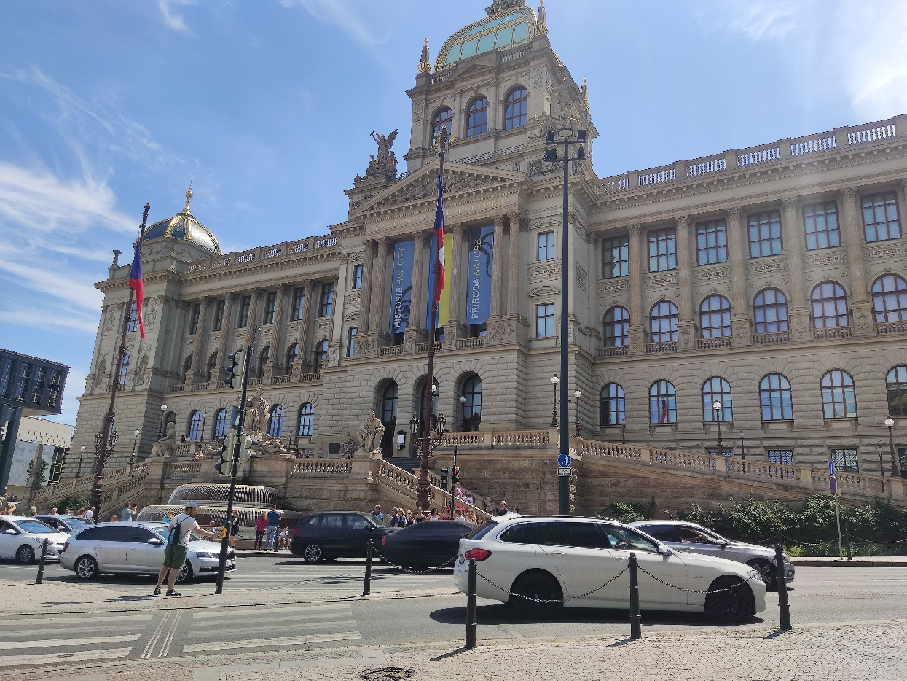
Prag Prague

Slide 27
Prag Prague

Slide 28
Prag Prague

Slide 29
Prag Prague

Slide 30
Prag Prague

Slide 31
Budimpešta Budapest

Slide 32
Sziget festival Budapest

Slide 33
Brno Brno

Slide 34
Hrana Food

Slide 35
Hrana Food

Slide 36
Pivo Beer

Slide 37
Pivo Beer

Slide 38
Pravdanje troškova Got to keep tabs on how much you drink

Slide 39
Hvala na pažnji Thanks AŽD Praha
Vidimo se uskoro, ako išta bar na pivu See you soon, if anything to get some beer

