Slide 1
Muzička produkcija
Stereo sistemi reprodukcije zvuka

Slide 2
Počeci i razvoj surround zvuka na filmu
Prvi komercijalno prihvatljivi vešekanalni formati reprodukcije zvuka razvijni su početkom 1950-tih godina za film (Nagli razvoj filmske industrije zbog konkurencije televizije)
Na bazi ovih iskustava sedamdesetih i osamdesetih godina prošlog veka usavršavaju se na filmu analogni Surround formati (Dolby stereo, Dolby SR)
Početkom devedesetih – digitalni Surround formati (CDS, Dolby Digital, DTS, SDDS)

Slide 3
Analogni formati na filmu

Slide 4
Prvi formati višekanalnog tona na filmu
Jednokanalni ton: svetlosni zapis
Pseudo – stereofonski ton (perspekta ton): svetlosni zapis
Sinema Scope – (35 mm): 4 kanala, magnetni zapis
Todd-AO – (70 mm): 6 kanala, magnetni zapis

Slide 5
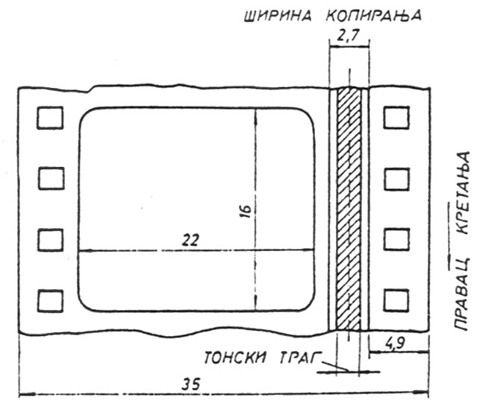
Jednokanalni optički zapis na filmskoj traci

Slide 6
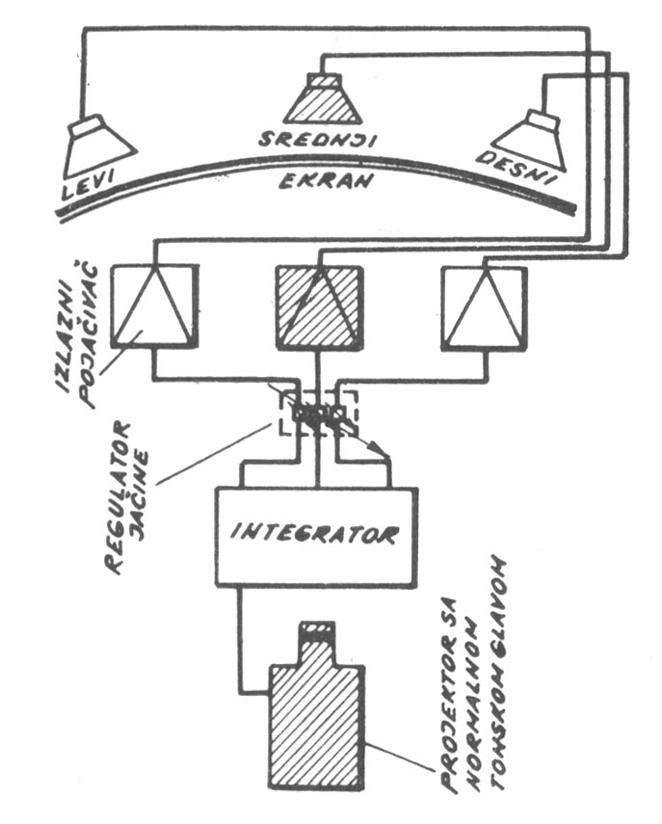
Perspekta – optički ton
Jednokanalni oprički ton koji se dovodi na tri zvučnika intenzitetom koji definišu tri kontrolna signala (30 Hz, 35 Hz i 40 Hz), zavisno od položaja izvora zvuka na slici
Kontrolni signali su usnimljeni preko osnovnog audio signala (60 Hz - 8 kHz)

Slide 7
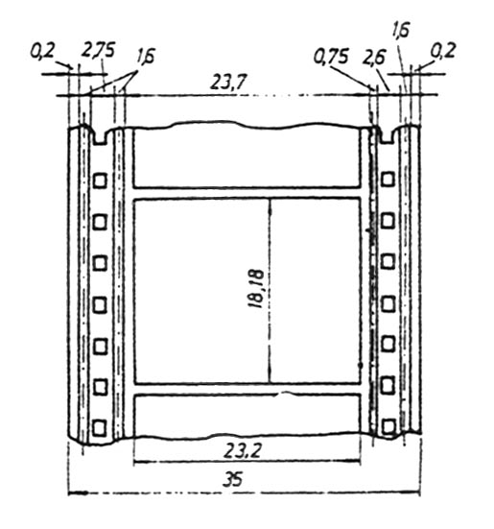
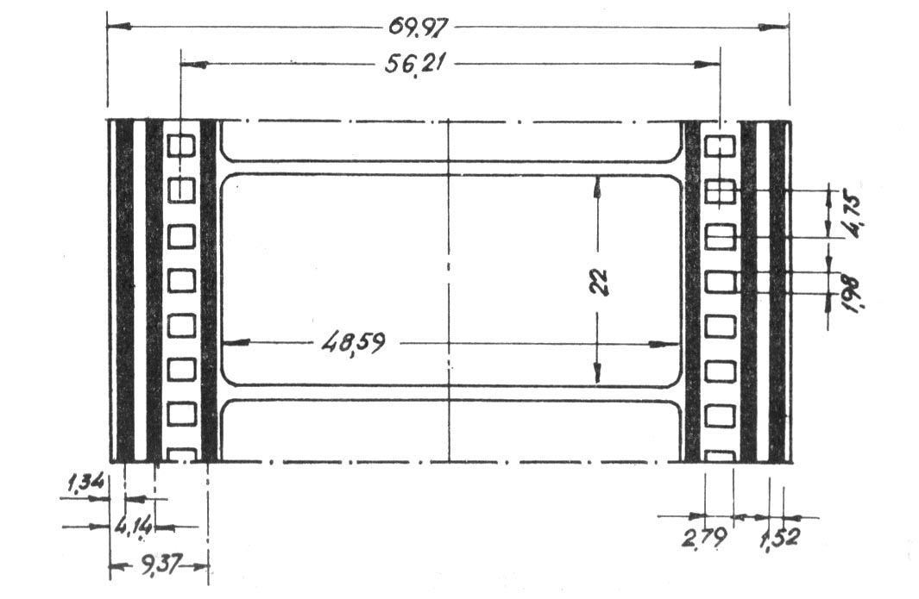
Višekanalni magnetni zapisi na filmskoj traci
Sinema Scope – (35 mm): 4 kanala
Todd-AO – (70 mm): 6 kanala

Slide 8
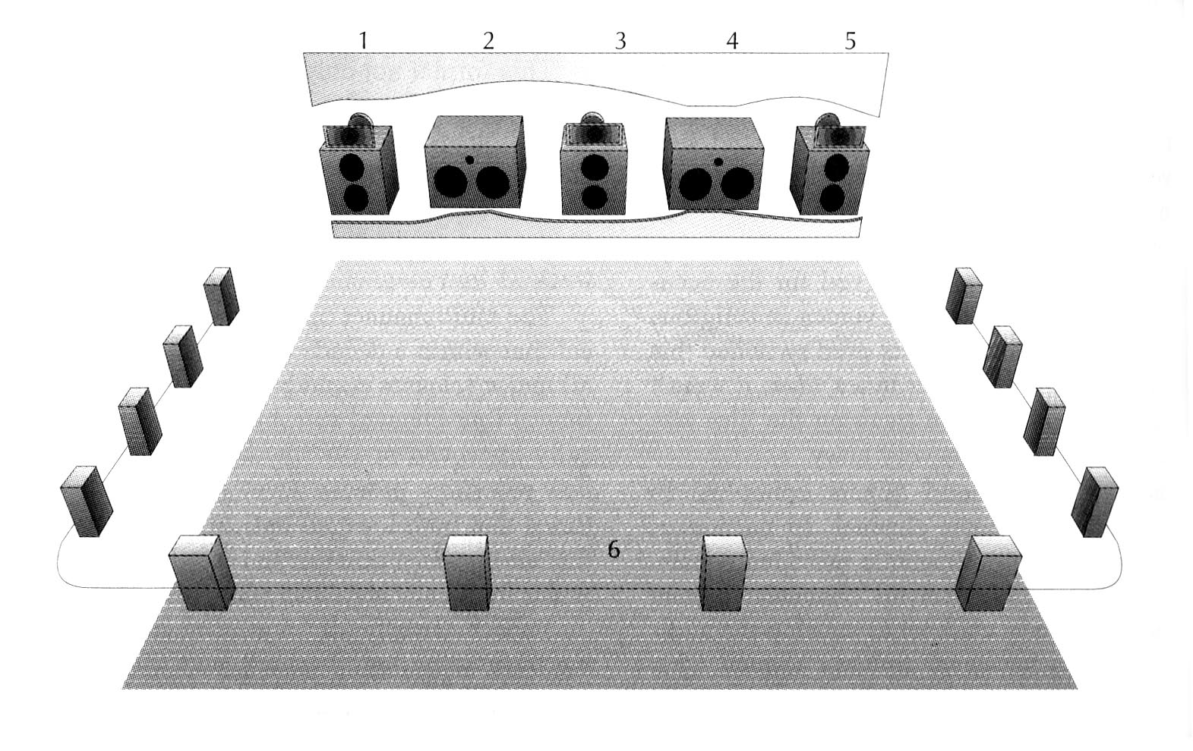
Reprodukcija 6 kanala u Todd-AO sistemu

Slide 9
Gašenje magnetnog zapisa na filmu
I pored znatno poboljšanog kvaliteta tona na filmu korišćenjem traka sa magnetnim tragovima, primena ovog sistema u praksi, nakon početnog “buma” počinje da opada
Osnovni razlozi:
Veća cena trake sa magnetnim tragovima
Kraći vek trajanja trake sa magnetnim tragovima
Visoka cena održavanja i opreme za reprodukciju

Slide 10
Analogni optički višekanalni formati na filmu
1977 – Dolby stereo (Dolby analog)
1986 – 1990 Dolby SR (Spectral Recording)

Slide 11
1977 – Dolby stereo (Dolby analog)
Standardna filmska traka – 35 mm – na istoj širini kao za raniji mono optički kanal usnimavaju se dva tonska optička zapisa
Dva optička zapisa nose podatke za 4 kanala (levi i desni kanal sa matrično kodiranim podacima za kanal C i surround (ambijent kanal i efekte)
Reprodukcija: dekoder 2:4
Proces kodiranja i dekodiranja: 4:2:4

Slide 12
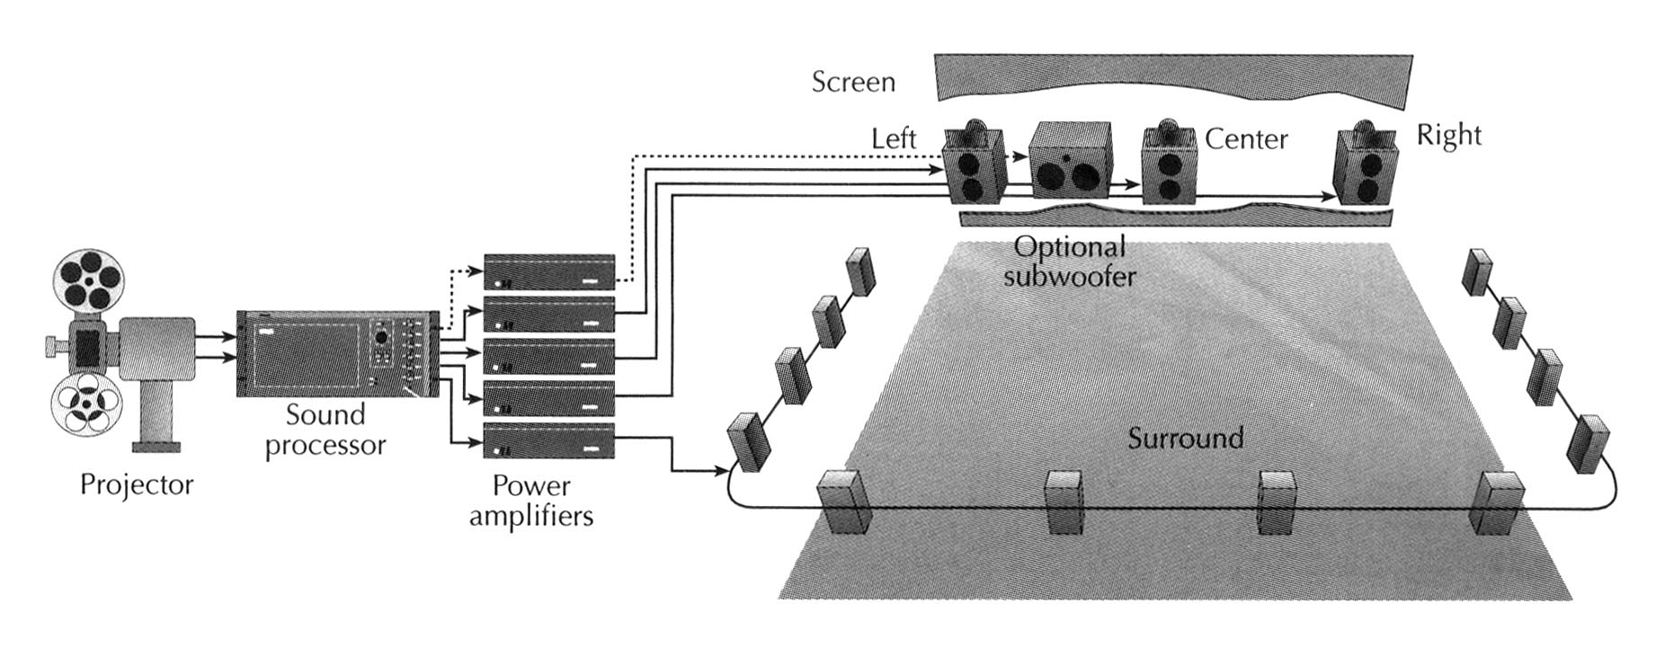
Dolby stereo
Postupak dekodiranja i raspored zvučnika

Slide 13
1986 – 1990 Dolby SR (Spectral Recording)
Poboljšana verzija - eliminacije šuma (na bazi ranijih formata: Dolby A, B i C)
Primenjena u skoro svim modernim profesionalnim analognim snimcima (na traci)
Koristi se kao oprički analogni format na skoro svim 35 mm filmskim kopijama – Dolby SR analog

Slide 14
Digitalni višekanalni formati na filmu

Slide 15
1990 – prvi 5.1 kanal – ni digitalni format: Cinema Digital Sound (CDS) – Optical Radiation Corporation + Kodak

Slide 16
Početak 90tih godina XX veka – pojavila su se tri konkurentska digitalna audio formata za 35 mm- ski film
Dolby Digital
Digital Theatre Sound (DTS)
Sony Dynamics Digital Sound (SDDS)
Razlikuju se više po tome kako su rešeni njihovi digitalni audio kanali na traci nego po aktuelnim perfomansama

Slide 17
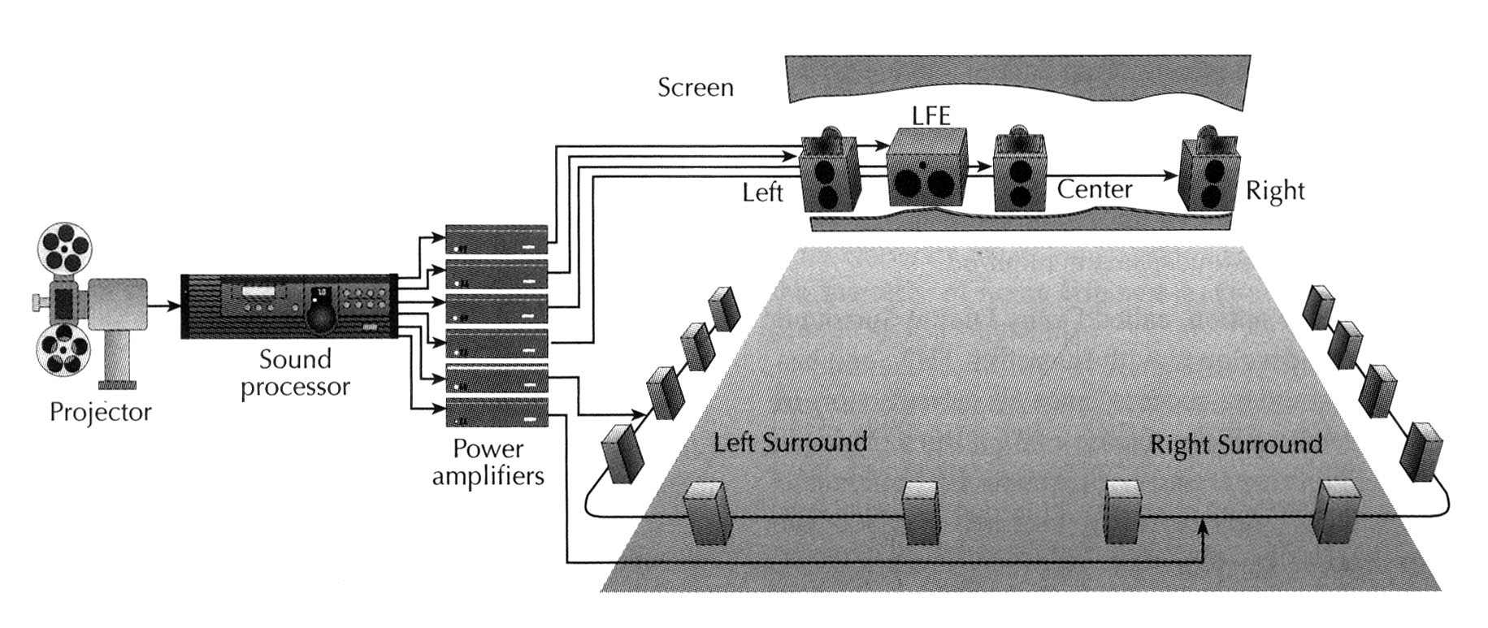
5.1 sistem – usvojen kao industrijski standard

Slide 18
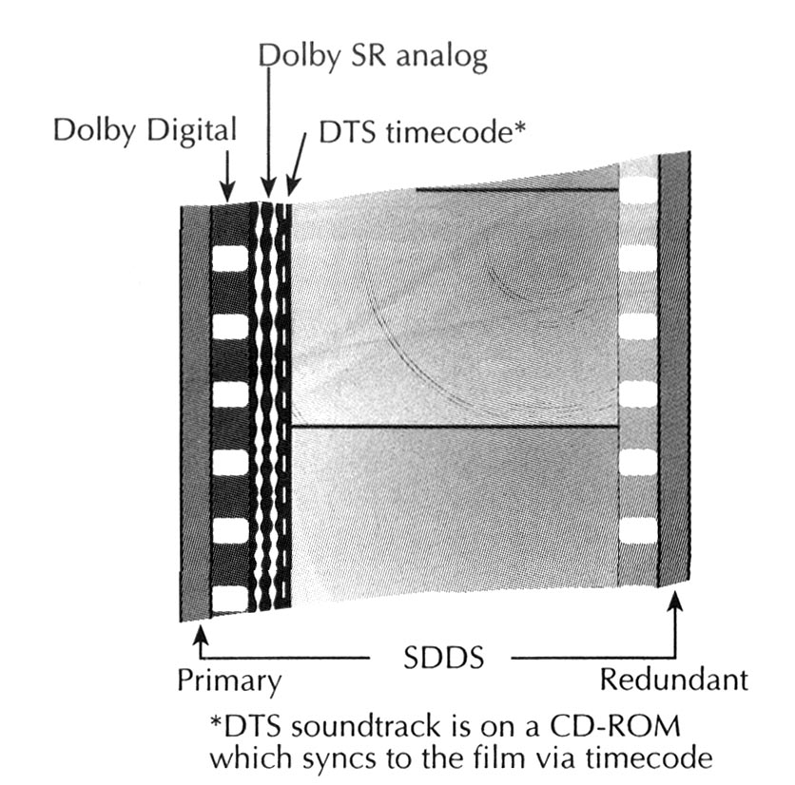
Univerzalna filmska traka 35 mm

Slide 19
DTS
DTS (Digital Theater Sound) – Steven Spielberg, Jurassic Park (1993.).
Compared with the Dolby Digital standard, DTS uses four times less compression and digitises sound at 20 bits instead of 16. Therefore, DTS's sound quality is theoretically higher, at the cost of a higher bit rate.
DTS 6, the most commonly used 5.1 standard, which can encode six-channel sound with less compression than the Dolby Digital standard. The first five channels are used for the satellite speakers, while the last is reserved for the subwoofer

Slide 20
DTS ES (Digital Theater Sound Extended Surround), 6.1 standard which uses an additional rear channel (rear central).
The DTS ES standard has two variants:
DTS ES Matrix, which has a seventh channel interpolated with the primary channels. This is called "virtualisation".
DTS ES Discrete has an seventh independent channel.

Slide 21
Dolby Digital EX
Dodatni zadnji kanal, sistem 6.1, ideja je da se popuni eventualni nedostatak u osećaju zvuka koji dolazi sa zadnjeg zida sale za projekciju
dodatni surround kanal, matrično kodiran u postojećim surround (levi i desni) kanalima standardnog digitalnog audio zapisa
(Obezbeđena je kompatibilnost sa standardnim 5.1 sistemom za reprodukciju. Korisnici koji žele dodatni surround kanal moraju imati dodatnu dekoder jedinicu i pojačavač snage. Mogu se prespajanjem iskoristiti već postojeći surround zvučnici).

Slide 22
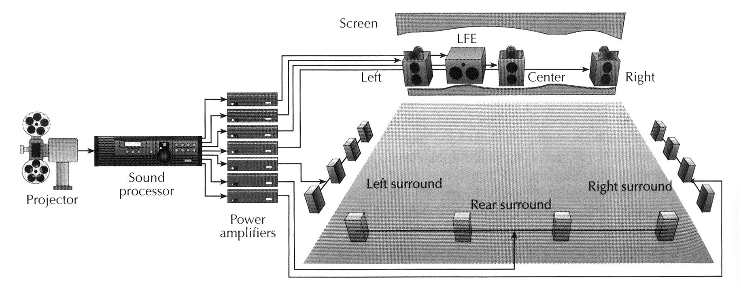
Dolby Surround Ex

Slide 23
SDDS - 1993
Sony Digital Dynamic Sound
5 screen channels (Left, Left center, Center, Right center, Right)
+
2 surround channels (Left surround, Right surround)
+
Subwoofer channel
Most installations use the 6-channel configuration. The 8-channel configuration is used only when the screen is large enough to handle the additional speakers between the screen.

Slide 24
Varijacije sistema 5.1 za bioskope
SDDS – nudi dodatne kanale na poziciji iza platna u punom frekvencijskom opsegu: polu–levi i polu-desni (sistem 7.1)
Dolby Digital Surround EX – dodatni surround kanal, matrično kodiran u postojećim surround (levi i desni) kanalima standardnog digitalnog audio zapisa
(Obezbeđena je kompatibilnost sa standardnim 5.1 sistemom za reprodukciju. Korisnici koji žele dodatni surround kanal moraju imati dodatnu dekoder jedinicu i pojačavač snage. Mogu se prespajanjem iskoristiti već postojeći surround zvučnici).

Slide 25
Digitalni višekanalni formati za kuću

Slide 26
The term "multichannel audio" refers to the use of multiple audio tracks to reconstruct sound on a multi-speaker sound system.
Two digits separated by a decimal point (2.1, 5.1, 6.1, 7.1, etc.) are used to classify the various kinds of speaker set-ups, depending on how many audio tracks are used.
The first digit shows the number of primary channels, each of which are reproduced on a single speaker, while the second refers to the presence of a Low Frequency Effect (LFE for short), which reproduced on a subwoofer. Thus, 1.0 corresponds to mono sound (meaning one-channel) and 2.0 corresponds to stereo sound.

Slide 27
For any given number of audio channels, there is an optimal physical setup for the speakers that produces the best effect possible. For this reason, special icons are placed on surround sound equipment to symbolise the number of channels and the physical placement of the speakers. Small black squares (one for each channel) are placed in a square that represents a room to indicate how to set them up:

Slide 28
Dolby surround -1982
Dva kanala + surround kanal (upper frequency limit of 7 kHz + delay time of about 20 ms )
Dolby surround Pro Logic (Dolby Pro Logic – 1987)
Two side speakers in front
One central speaker (for reproducing the actors' voices )
Two rear surround speakers (in mono)
Dolby Pro Logic II- 2000
5.1 sound environment, by applying computer processing to a stereo source (2.0) or Dolby Surround (3.0/4.0/4.1).

Slide 29
Dolby Pro Logic IIx- 2003
can artificially reconstruct a 6.1 or 7.1 sound environment from a stereophonic source
It offers several sound ambiance settings depending on how the speakers are being used:
Movie for playing films,
Music for playing audio CDs,
Game for videogames.

Slide 30
Dolby Pro Logic kućni bioskop

Slide 31
Dolby Digital kućni bioskop

Slide 32
Decoder | Encoder | Year | Description | Channels
 | Dolby Stereo | 1975 | Cinema use. | FL FR with C and RearMono matrixed
Dolby Surround | Dolby Surround | 1982 | First Home use. Analog. | FL FR with C and RearMono matrixed
 | Dolby SR | 1986 | Cinema use. | FL FR with C and RearMono matrixed
Dolby Pro Logic |  | 1987 | Improved Dolby Surround. Upmix Stereo to Surround 4.0. | FL FR with C and RearMono matrixed
Dolby Pro Logic II |  | 2000 | Improved Dolby Pro Logic. Upmix Mono(in Matrix mode) or Stereo to Surround 5.1 in either Matrix, Movie, Music, or Game mode. | FL FR C SL SR SUB
Dolby Pro Logic IIx |  |  | Upmix Stereo or Surround 5.1 to 6.1 or 7.1 in either Movie, Music, or Game mode. | FL FR C SL SR SUB and RearMono(x2)
Dolby Digital | Adaptive Transform Coder 3 (AC3) | 1992 Film 1995 Laser Disc | Discrete channel encoder/decoder. Pro Logic Decoder can be used for downmixed stereo inputs. | FL FR C SL SR SUB
Dolby Digital EX/Dolby Digital Surround EX |  | 1999 | 6.1 or 7.1 (5.1 with Center Rear matrixed onto SL & SR) | FL FR C SL SR SUB RearMono(x1 or 2x)
 | Dolby Digital Plus |  | High bitrate. Currently uses 7.1 channels with support for more.
 | Dolby TrueHD |  | Lossless encoder for High Definition Video Sound. Eight full-range channels of 24-bit/96 kHz. Higher Bitrate than DD-Plus.
 | Dolby Digital Live |  | On the Fly 5.1 encoder for Games.

Slide 33
Dolby Surround | Left | Right | Center | Surround
Left Total | 1 | 0
Right Total | 0 | 1
j = +90° phase-shift, k = -90° phase-shift

Slide 34
Dolby Pro Logic | Left | Right | Center | Rear Left | Rear Right
Left Total | 1 | 0
Right Total | 0 | 1
j = +90° phase-shift, k = -90° phase-shift

Slide 35
Dolby Pro Logic II | Left | Right | Center | Rear Left | Rear Right
Left Total | 1 | 0
Right Total | 0 | 1
j = +90° phase-shift, k = -90° phase-shift

Slide 36
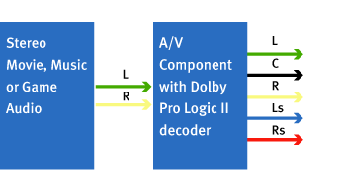
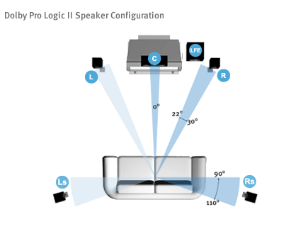

Slide 39
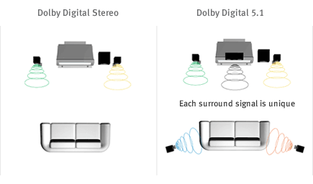

Slide 40
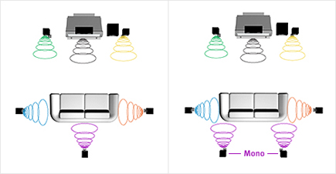
Dolby digital EX 6.1 i 7.1

Slide 41
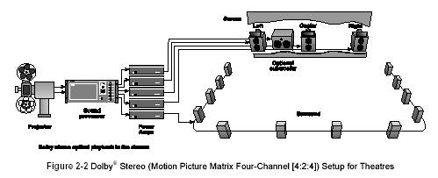
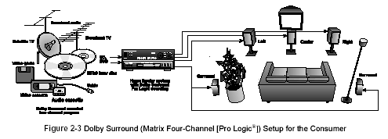

Slide 42
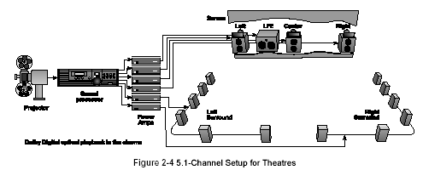
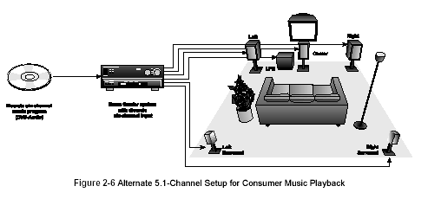

Slide 43
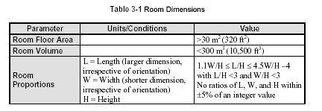
Room dimensions
A minimum height of 3 meters (9 feet) is desirable.

Slide 44
Acoustics
Early Reflections
Any early reflections (within 15 ms) should be at least 10 dB below the level of the
direct sound for all frequencies in the range 1 kHz to 8 kHz [6].
Reverberation Field
Reverberation time is frequency-dependent. The nominal value, Tm, is the average of
the measured reverberation times in the 1/3-octave bands from 200 Hz to 4 kHz and
should lie in the range: 0.2 < Tm < 0.4 s. Tm should increase with the size of the room;
the formula in Table 3-2 is a guide.
The reverberation time T, measured in 1/3-octave bands over the frequency range
from 63 Hz to 8 kHz, should conform to the tolerance mask shown

Slide 45
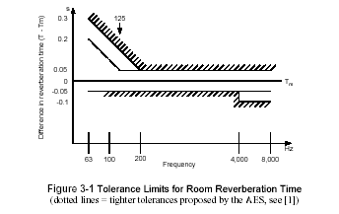

Slide 46
Background Noise
The listening area should ideally achieve an NC rating of 10 or below with the
equipment off, measured at the reference position. A studio with equipment such as
video projectors, video monitors, and other ancillary equipment powered on should
achieve a rating of ¡Ü NC 15.
Any background noise should not be perceptibly impulsive, cyclical, or tonal in nature.

Slide 47
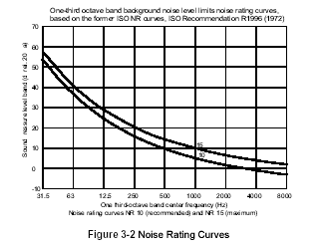

Slide 48
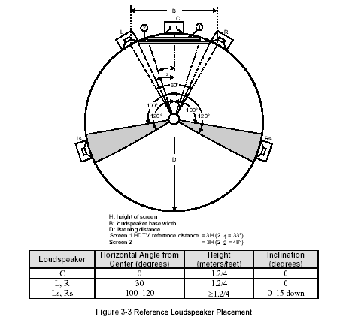

Slide 49
Console Placement
In most cases, the console should be placed equidistant from the listening studio
sidewalls. Lateral placement is discussed in Section 3.3.
Reference Positions
The reference position of the mixer’s head is typically:
• At the center of the console
• Equidistant from the sidewalls
• Directly above the rear edge (arm rest) of the mixing console
• 1.2 meters (¡Ö 48 inches) off the floor
This imaginary point is the reference point for all speaker distances and aiming angles.

Slide 50
